Slide 1
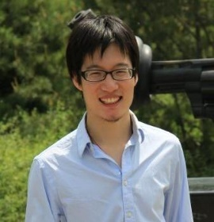
Long Short Memory Process: Modeling Growth Dynamics of Microscopic Social Connectivity
${Chengxi Zang}^{1}$, ${Peng Cui}^{1}$, ${\text{Christos} \text{Faloutsos}}^{2}$, ${Wenwu Zhu}^{1}$
${}^{1}$Tsinghua University
${}^{2}$Carnegie Mellon University
Notes:
Good morning everyone, this is Chengxi Zang from Tsinghua Univ. My presentation is about the dynamics of how you add friends. The title is …. This is a joint work with Peng Cui and Wenwu Zhu from Tsinghua U, Christos Faloutsos from CMU.

Slide 2
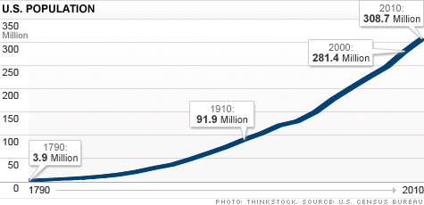
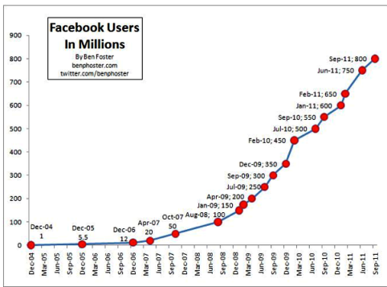
Introduction
Method
Experiments
Conclusion
Growth Phenomenon - Social Network
Physical Society
Online Social Media
Notes:
The growth phenomenon of Social Network is ubiquitous in both physical society and online social media. For example, the growth of US population, the growth of Facebook users, the growth of WeChat users, and so on.

Slide 3
Microscopic Social Connectivity Growth
Introduction
Method
Experiments
Conclusion
Macro
Social Network growth
Spatially-Temporally
Aggregated
Add Friend by
Micro
Social Connectivity
Growth
Notes:
However, the evolution of SNs like WeChat and Facebook, which have hundreds of millions of users and billions of links, are driven by the growth of each individual’s social connectivity. You add friends, your ego network grow, and these microscopic social connectivity growth is spatially-and-temporally aggregated into macro social network growth. Thus, in order to understand the macro social network growth phenomenon, we need to study their microscopic building blocks.

Slide 4
Importance
Introduction
Method
Experiments
Conclusion
Universal human dynamics
Microscopic mechanisms for network growth
Broad applications: Clustering, Prediction, Outlier detection, etc.
Notes:
The understanding of the microscopic social connectivity growth is of vital importance. Because it can advance our understanding on the universal human dynamics, provide the microscopic mechanisms for social network growth, and lead to a broad range of applications, including clustering, prediction, outlier detection, and so on so forth.

Slide 5
The Problem
Introduction
Method
Experiments
Conclusion
Big-Data-Driven:
WeChat
300M users
4.75B links
first 2 years
Problem:
How the number of your friends grows over time?
Patterns?
Mechanisms?
A unified model?
#Friends $k_{i}$
Time
Notes:
By a data-driven approach, we study the detailed evolution traces of the largest social network in China--WeChat, from zero to 300 million users and 4:75 billion friendships spanning its first two years. The dataset explicitly records when, where and how a link is established, serving as one of the largest datasets support the study of micro growth dynamics.
Mathematically, we try to figure out how the number of your friends grows over time? Focusing on this growth dynamics, we try to answer: 1.What are the patterns of these micro growth dynamics? What are the plausible mechanisms governing these growth dynamics? Can we propose a unified model to capture the growth dynamics of largely heterogeneous individual?

Slide 6
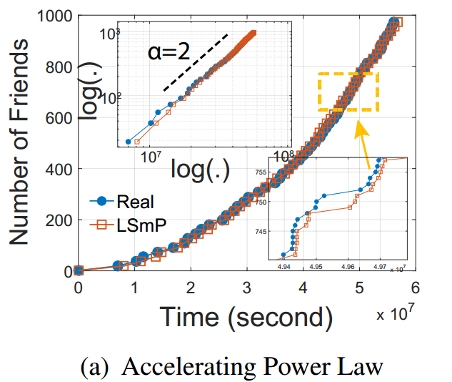
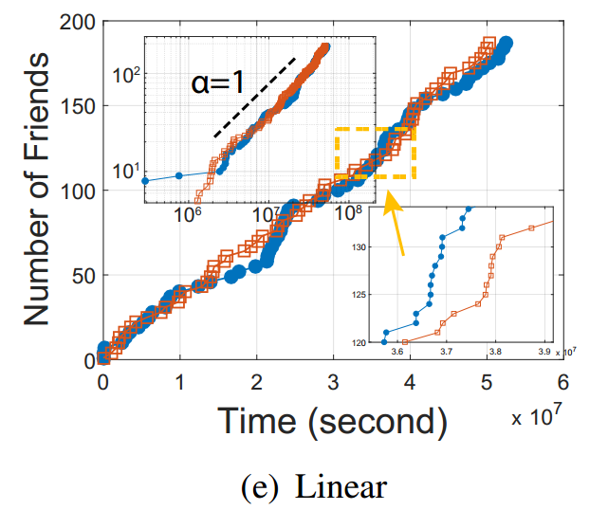
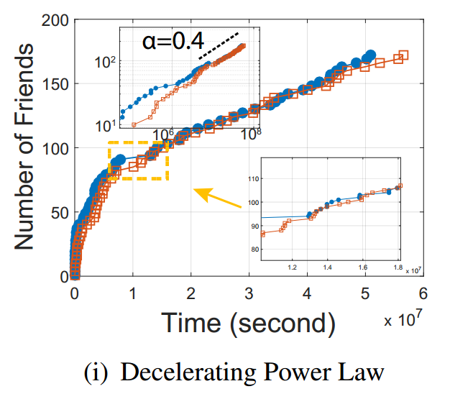
Findings
Introduction
Method
Experiments
Conclusion
Long-term: A wide range of power-law growth
Short-term: Stochastic bursts
1
Al lthe previous findings failed!
Notes:
By investigating the real data, we find the growth dynamics of your number of friends exhibit rich complexities. We showcase three individuals’ growth dynamics over two years, we find i) a wide range of power law growth in the long term, and ii) stochastic bursts in the short term.

Slide 7
Limitation of Existing Models
Introduction
Method
Experiments
Conclusion
Network evolution
Sub-linear growth
$k_{i}(t)\sim t^{0.5}$ BA model, Science’99: Mean field; No heterogeneity; No densification.
$k_{i}(t)\sim t^{α}$ $α$ < 1 Fitness model, EPL’01: No densification.
Linear growth
$k_{i}(t)\sim t$, COSN’13: Mean field; No heterogeneity.
Super-linear growth
$k_{i}(t)$ is super-linear growth, KDD’08: Mean field. No heterogeneity.
All existing models failed
Notes:
However, the existing models on network evolution found: the sub-linear growth of your number of friends, like the BA model and the Fitness model; The linear growth, And the super-linear growth.
Thus, all the existing models failed in capturing the growth dynamics we observed in the real world.

Slide 8
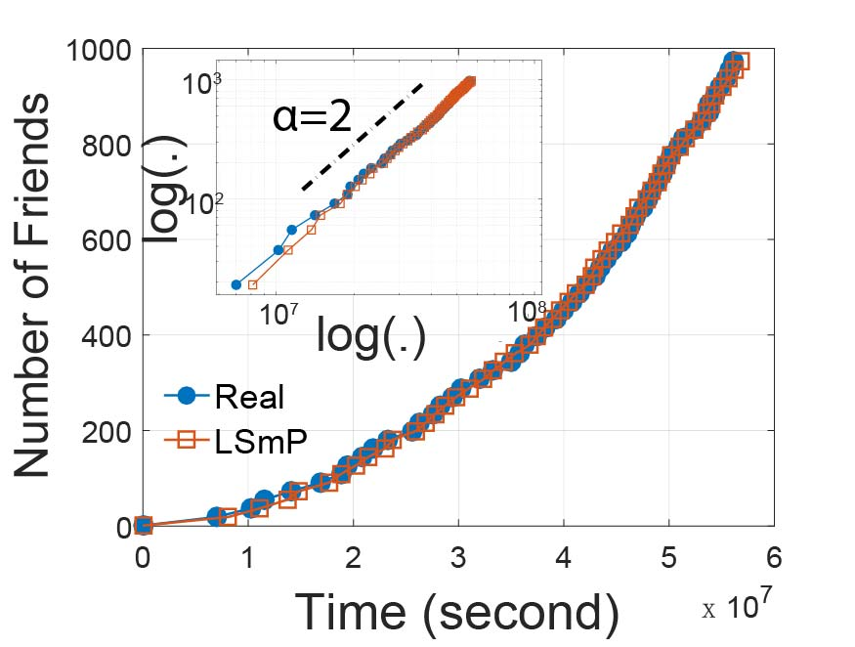
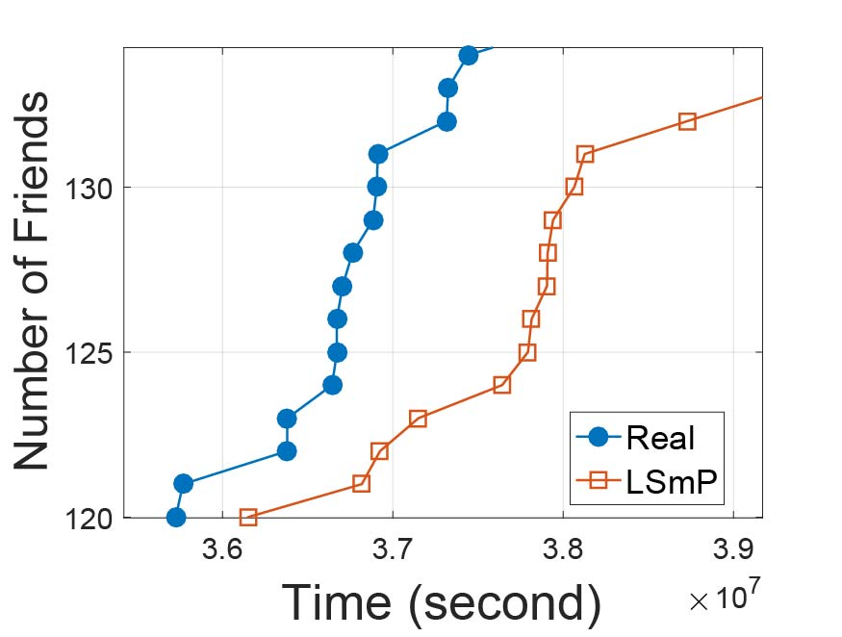
Mechanisms
Introduction
Method
Experiments
Conclusion
Long-term power law growth.
Short-term stochastic bursts.
We need a unified model to generate both growth patterns
Notes:
So far, we find two growth patterns in real world, the long-term power law growth, and the short-term stochastic bursts. And the previous models failed. Thus, we want to know the mechanisms governing the observed patterns. We need a unified model to generate both growth patterns.

Slide 9
Mechanisms – Long Term Memory
Introduction
Method
Experiments
Conclusion
Average-memory-effect
Intuition: The behavior at present is influenced by the whole history in an average manner.
Model: The rate of making friends at present $\frac{dn(t)}{dt}$ is proportional to the average rate $\frac{n(t)}{t}$ of making friends so far.
Power law growth:
$\frac{dn(t)}{dt}$ = $\frac{β}{t^{θ}}n\left(t\right)(N −n(t))$
$\frac{dn(t)}{dt}$ = $α$ $\frac{n(t)}{t}$
(KDD’16)
When $θ=1$ and $n\left(t\right)≪N.$ By defining $α= βN,$ we get:
$$n\left(t\right)=n_{0}{\left(\frac{t}{t_{0}}\right)}^{α}$$
Notes:
Let me elaborate on the mechanisms and then propose a unified model. The first mechanism is a kind of long term memory, and we name it average-memory-effect which generates long-term power law growth. The intuition behind the average-memory-effect is <…..>. And we model the average-memory-effect as follows. <….>. The generation of power law growth can be proved by following equations.

Slide 10
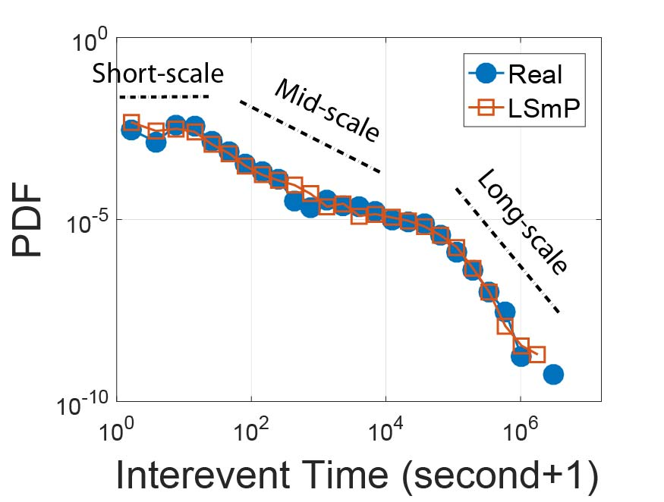
Mechanisms – Short Term Memory I
Introduction
Method
Experiments
Conclusion
Multiscale-memory-effect
Intuition: Memory fades due to the mere passage of time since last event.
Model: The multiscale inter-event time (IET) $τ$ distribution $P\left(τ\right)$:
Flat short-scale
Fat-tailed middle-scale
Exponential-like long-scale
Burst: Intense activities followed by long vacation
…
$$τ_{}$$
Notes:
The second mechanism is a kind of short-term memory, we name it multiscale-memory-effect. The intuition is : the memory fades due to the mere passage of time since last event. But how does the memory decay? We model the multiscale-memory-effect by the inter-event-time distribution P(tau). An illustration below shows the definition of inter-event-time. The axis represents the event time sequence and the tau represent the time between consecutive two events. The right figure showcases one empirical IET distribution , We find flat short-scale, fat-tailed middle-scale, and the exponential-like long-scale. When we i.i.d. sample IETs from a multiscale distribution, a sequence of small value IETs occur in shortscale, followed by large value IET in the middle-scale and long-scale, generating intensive activities followed by long vacation, namely, bursts.

Slide 11
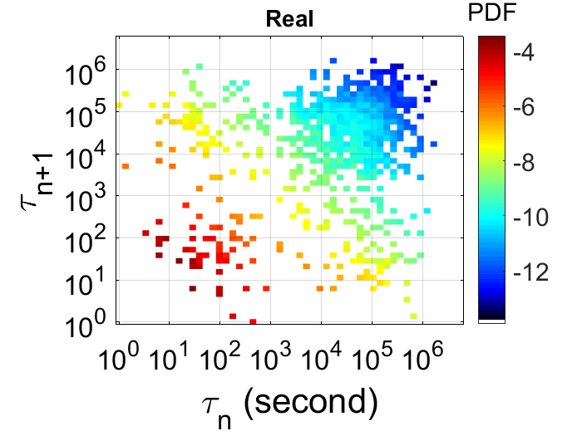
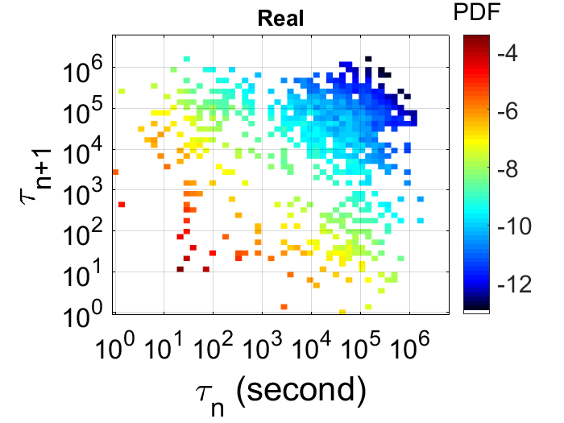
Mechanisms – Short Term Memory II
Introduction
Method
Experiments
Conclusion
Correlated-memory-effect
Intuition: The latest IETs are correlated rather than independent
Model: $P\left(τ_{i+1}, τ_{i}\right)=P(τ_{i+1},|τ_{i})P(τ_{i})≠P(τ_{i+1})P(τ_{i})$.
Bursts: Correlated IETs
…
$$τ_{i}$$
$$τ_{i+1}$$
$$P\left(τ_{i}, τ_{i+1}\right)$$
shuffled$P\left(τ_{i}, τ_{i+1}\right)$
Notes:
The third mechanism is another kind of short-term memory, we name it correlated-memory-effect. The intuition is : The latest IETs are correlated rather than independent. Mathematically, the joint distribution of two consecutive interevent times is not equal to the product of marginal distribution. If we rearrange an IET sequence as follows: make small value IET together and followed by the large value IETs, and then we also get bursts. Thus, the correlations between IETs can also generate bursts.

Slide 12
The Long Short Memory Process (LSMP)
Introduction
Method
Experiments
Conclusion
Framework: Temporal point process
Hazard rate definition:
Hazard rate of LSMP:
$$λ\left(t | ℋ_{t}\right)=\frac{𝔼[n(dt)|ℋ_{t}]}{dt}$$
$$λ\left(t | ℋ_{t}\right)= λ_{∞}a{(\frac{t}{∆_{∞}}+1)}^{a−1}+\sum_{i=n\left(t\right)−m+1}^{n(t)}{λ_{0}{(\frac{t−t_{i}}{Δ_{0}}+1)}^{−θ}}$$
Long-term memory part
Short-term memory part
Notes:
Based fundamentally on the three memory effects, we propose the Long-Short-Memory-Process LSmP. We follow the temporal point process framework by modeling the hazard rate. The hazard rate describes the rate of the occurrence of the event given the history of previous events. The hazard rate of LSmP has two parts: namely, long-term memory part and short-term memory part respectively.

Slide 13
The Long Short Memory Process
Introduction
Method
Experiments
Conclusion
DETAILS
$$λ\left(t | ℋ_{t}\right)= λ_{∞}a{(\frac{t}{∆_{∞}}+1)}^{a−1}+\sum_{i=n\left(t\right)−m+1}^{n(t)}{λ_{0}{(\frac{t−t_{i}}{Δ_{0}}+1)}^{−θ}}$$
Long-term memory part
Short-term memory part
Various stochastic power-law growth
a < 1: Decelerating power-law growth
a = 1: Linear growth
a > 1: Accelerating power-law growth
Notes:
Let me elaborate on the hazard rate equation. The average-effect, in the hazard rate language, namely the present hazard rate is the mean value of its previous hazard rate, generates stochastic power-law dynamics with arbitrary exponents a. When a < 1, the process generates decelerating pl growth. When a = 1, the process generates a constant growth rate. When a > 1, the accelerating pl growth appears, implying a rich-get-richer phenomenon.

Slide 14
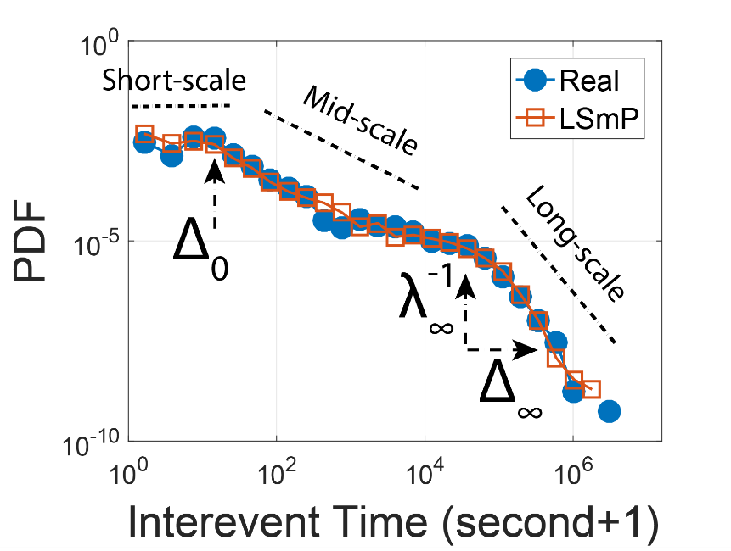
The Long Short Memory Process
Introduction
Method
Experiments
Conclusion
DETAILS
$$λ\left(t | ℋ_{t}\right)= λ_{∞}a{(\frac{t}{∆_{∞}}+1)}^{a−1}+\sum_{i=n\left(t\right)−m+1}^{n(t)}{λ_{0}{(\frac{t−t_{i}}{Δ_{0}}+1)}^{−θ}}$$
Long-term memory part
Short-term memory part
Multiscale IET distribution
Bursty short-scale:
Fat-tailed middle-scale: $θ$
$θ=1$: power-law decay
$θ≠1:$ stretched exponential decay.
Bimodal long-scale:
$$θ$$
$$λ_{0}, Δ_{0}$$
Burst!
$$λ_{∞}, Δ_{∞}$$
Notes:
The multiscale inter-event distribution is captured by LSmP. Specifically, $λ_{0}, Δ_{0}$
control the bursty short-scale. The theta control the fat-tailed middle-scale. When theta = 1, the process gives rise to power-law decay. Otherwise, the process generates stretched exponential decay. See the paper for the detailed proof of why different theta generate different decay form. The second mode in the long-scale is captured by the $λ_{∞}, Δ_{∞}$. The intensive activities followed by long vacation generates bursts.

Slide 15
The Long Short Memory Process
Introduction
Method
Experiments
Conclusion
DETAILS
$$λ\left(t | ℋ_{t}\right)= λ_{∞}a{(\frac{t}{∆_{∞}}+1)}^{a−1}+\sum_{i=n\left(t\right)−m+1}^{n(t)}{λ_{0}{(\frac{t−t_{i}}{Δ_{0}}+1)}^{−θ}}$$
Long-term memory part
Short-term memory part
IETs’ correlation
Long-range correlation
a > 1: Positive correlation
a < 1: Negative correlation
Short-range correlation
Superposed fizzling kernel
Burst!
$$P\left(τ_{i}, τ_{i+1}\right)$$
Notes:
The correlation of iets are also captured by our model. When a > 1, the accelerating growth gives positive correlation of iets, while a < 1, the decelerating growth gives negative correlations. The superposition of latest m fizzling kernels gives short-range correlation! The correlations generate burst

Slide 16
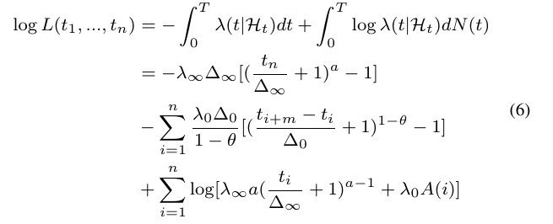
Parameter Learning & Simulation
Introduction
Method
Experiments
Conclusion
DETAILS
Probability framework, MLE
Closed-form gradients
Simulation algorithms of LSMP
Inverse method
Ogata’s thinning algorithm for $α≤1$
Code @
https://github.com/calvin-zcx/LSMP
Notes:
We learn the parameters of LSmP by maximizing log-likelihood function. A good advantage of LSmP is that all the parameters have closed-form gradients. We can adopt a wide range of optimization algorithms. We also design the simulation algorithm of LSmP. For brevity, we don’t talk much about the details. We have opensourced the code. For details please refer to the paper and code.

Slide 17
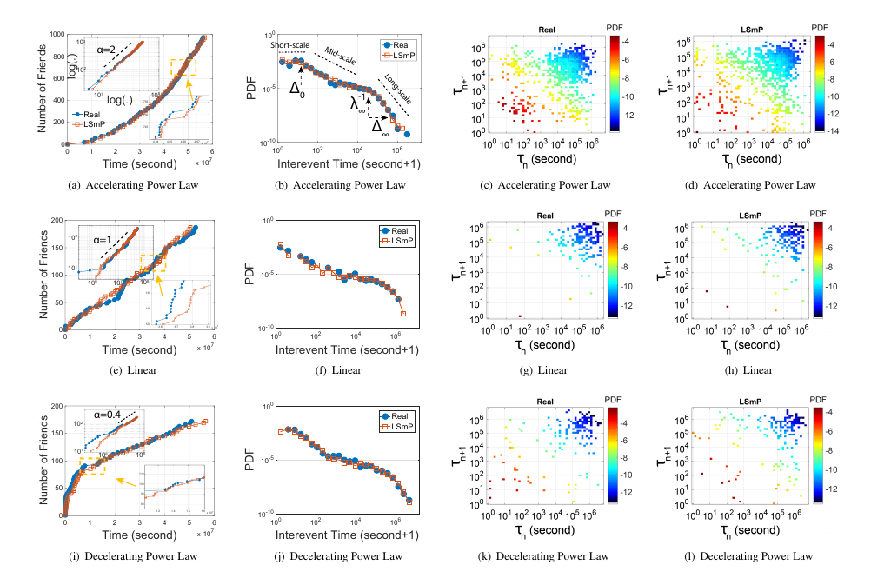
Experiments – 1. Fitting Accuracy
Introduction
Method
Experiments
Conclusion
Given: Real dynamics vs. Generated dynamics
Check points:
Growth curves
$P\left(τ\right)$
$P(τ_{i}, τ_{i+1})$
Notes:
All right, the experiment part. For each individual, we have its real dynamics and the generated dynamics. We first validate the fitting accuracy of LSmP by three check points: the growth shape, the multiscale IET distribution, and IETs’ correlation.

Slide 18
Experiments – 1. Fitting Accuracy
Introduction
Method
Experiments
Conclusion
Baselines:
Poisson process (PP) $λ\left(t | ℋ\right)=λ$
Hawkes process with exponential kernel (HWK-E) $λ\left(t | ℋ\right)=μ+ \sum_{t_{i}<t}{αe^{−β(t−t_{i})}}$
Hakes process with power law kernel (HWK-P) $λ\left(t | ℋ\right)=μ+ \sum_{t_{i}<t}{α{(t−t_{i})}^{−β}}$
Self-feeding process (SFP) $λ\left(t | ℋ\right)=\frac{1}{\frac{μ}{e}+ τ_{i}}$
Notes:
We consider following four representative human dynamic models for comparison. They are poisson process, hawkes process with different kernels, and the self-feeding process.

Slide 19
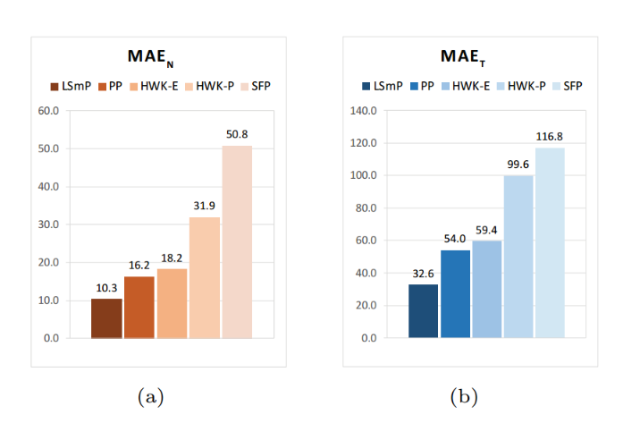
Experiments – 1. Fitting Accuracy
Introduction
Method
Experiments
Conclusion
Check point 1: Growth Curve Shape
Error of $n(t)$
Error of $t$
$×$5
$×$3.6
Notes:
We compare the mean average error of the real dynamics and the generated dynamics. As for the err bars, the lowe, the better. The proposed LSmP model fits the reality much better than the baselines for both the metrics.

Slide 20
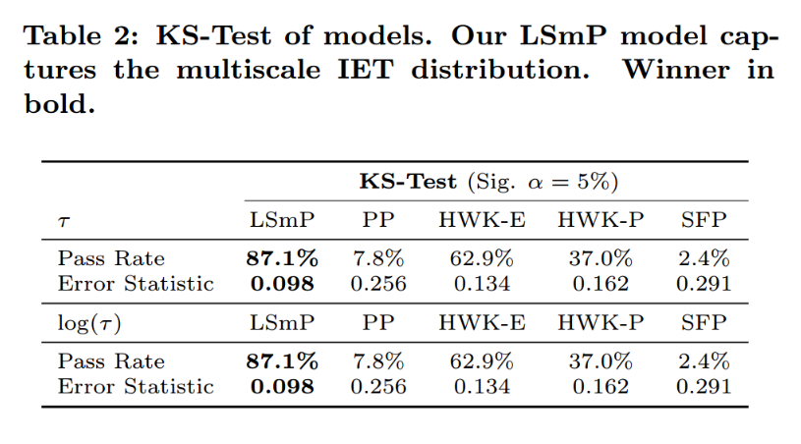
Experiments – 1. Fitting Accuracy
Introduction
Method
Experiments
Conclusion
Check point 2: Inter-event time (IET) distribution $P\left(τ\right)$
Hypothesis test $H_{0}: P\left(τ\right)$ == $P\left(\hat{τ}\right)$
Pass rate: the higher, the better.
Error: the lower, the better.
Notes:
We then demonstrate that the LSmP accurately captures the multiscale IET distribution of the growth dynamics. We test whether the real dynamics and the generated dynamics are from the same continuous distribution. The two-sample KS test is applied for this standard statistical test mission. We conduct the test on both the IET and log-transformed IET. The higher the pass rate, the better, and lower the error, the better. Our model outperforms all the baselines significantly in both the metrics.

Slide 21
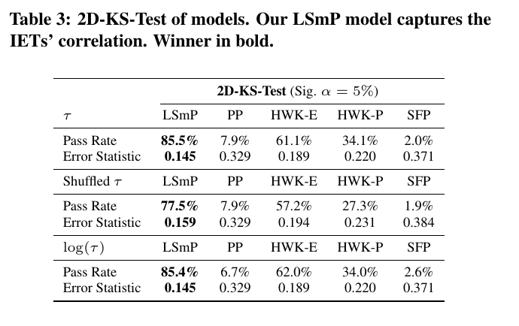
Experiments – 1. Fitting Accuracy
Introduction
Method
Experiments
Conclusion
Check point 3: IETs’ correlation-joint distribution $P(τ_{i}, τ_{i+1})$
Hypothesis test $H_{0}: P\left(τ_{i}, τ_{i+1}\right)==P(\hat{τ_{i}},\hat{τ_{i+1}})$
Notes:
We further show that our LSmP captures the correlation between the IETs by comparing the joint distributions. We apply the two-dimensional version of the KS test to test whether the real p(τi;j; τi;j+1) and the generated p(τ^i;j; τ^i;j+1) are the same. Again, LSmP beats all the baselines significantly in both metrics. What’s more, we also compare the shuffled tau and the log-transformed tau. We get similar results for log(tau). The maximal marginal gain from shuffled tau to tau implying we capture the correlation much better than baselines.

Slide 22
Experiments – 2. Statistical Regularity
Introduction
Method
Experiments
Conclusion
Long-term memory part
Rich heterogeneity in PL growth
a < 1: Decelerating power-law growth
a = 1: Linear growth
a > 1: Accelerating power-law growth
Multimodal rate (1 week)
Scale 4 days (Monday + 4 = Friday)
$$λ_{∞}a{(\frac{t}{∆_{∞}}+1)}^{a−1}$$
Notes:
One good advantage of LSmP is that all the modeling parameters have clear physical meanings. Thus, by analyzing the parameter space, we find some statistical regularity of the human dynamics. In the long-term, Fig a plots the distribution of PL growth exponent alpha for each individual, We find rich heterogeneity in power-law growth. Fig b plot the distribution of growth rate \lambda_infinity. We find a mixture of log-normal distributions spanning more than 8 order of magnitude, ranging from per second to per year. In average, people add a friend per week. Fig c plots the distritbuion of time scale Delta_infinity, best fitted by a skewed log-normal distribution. We find that the typical time scale of human dynamics of adding friends is near 4 days. One explanation: when you start a new job on Monday and establish a set of connections to your workmates until Friday, four days later!

Slide 23
Experiments – 2. Statistical Regularity
Introduction
Method
Experiments
Conclusion
Short-term memory part
Gaussian mixture fizzling exponent
$θ=1$: power-law decay
$θ≠1:$ stretched exponential decay.
Bimodal for rate and scale.
$$\sum_{i=n\left(t\right)−m+1}^{n(t)}{λ_{0}{(\frac{t−t_{i}}{Δ_{0}}+1)}^{−θ}}$$
Notes:
For the statistical regularity of the human dynamics in the short-term, we find Gaussian mixture distribution of fizzling exponent theta. But we find rather than the power law decay in the critical state when θ = 1, θ != 1 is more general, indicating a stretched exponential decay. We also find bimodal distribution for other short-term parameters.

Slide 24
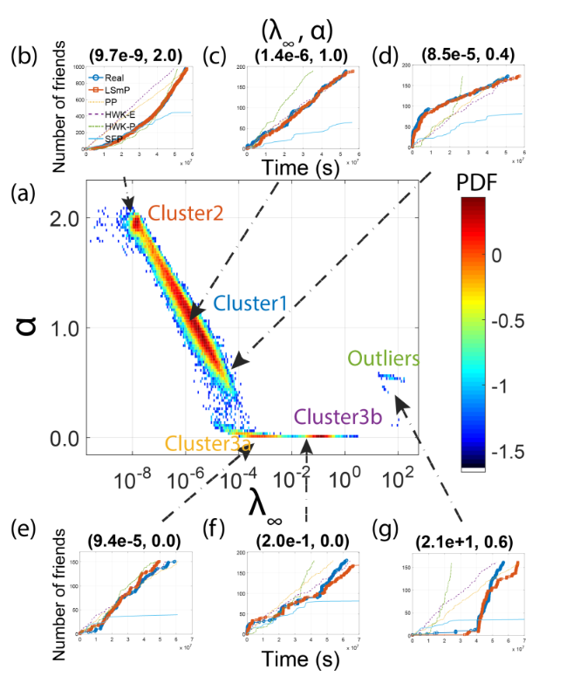
Experiments – 3. Clustering & Outliers
Introduction
Method
Experiments
Conclusion
Long-term memory part
$λ_{∞}, a$ space
Clusters
Outliers
$$λ_{∞}a{(\frac{t}{∆_{∞}}+1)}^{a−1}$$
Notes:
Due to the prevailing of the normal distribution and its variants (skewed or log) in empirical data, we apply the Gaussian mixture model to the parameter-space. We cluster the human growth dynamics, and at the same time we find some outliers. For example, a guy added a few friends within first 1 year, and added one hundred friends within few minutes. We find these outliers’ behaviors are money-driven, like this picture.

Slide 25
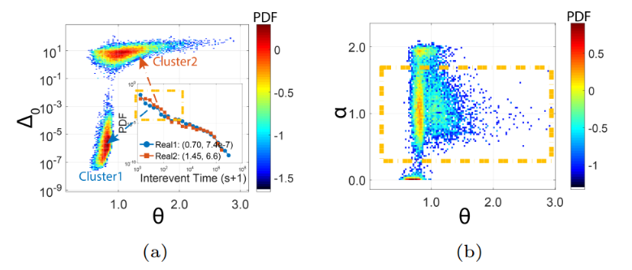
Experiments – 3. Clustering & Outliers
Introduction
Method
Experiments
Conclusion
$$\sum_{i=n\left(t\right)−m+1}^{n(t)}{λ_{0}{(\frac{t−t_{i}}{Δ_{0}}+1)}^{−θ}}$$
Short-term memory part
Clusters and Outliers in $θ,Δ_{0}$space.
Dependency between long-term and short-term
Growth exponent $v.s.$Fizzling term
Small
Notes:
The same clustering experiments are conducted in the short-term memory space. We find people in the upper cluster in fig a whose IET distribution has very clear flat short scale!
We further examine the correlation between the long-term parameters and the short-term parameters. We find large variance with respect to θ, implying the relatively small correlations between the long-term memory and short-term memory.

Slide 26
Conclusion
Introduction
Method
Experiments
Conclusion
Novel findings
2 Growth patterns: Long-term power-law growth & Short-term bursty growth
3 Memory effects: Average-memory-effect, Multiscale-memory-effect, Correlated-memory-effect
Novel Long Short memory Process (LSmP) model.
Parsimonious & Clear physical meaning & Closed-form gradients
Accuracy
Usefulness
Mining human dynamics (growth & fizzling), Clustering, Pattern mining, Outlier detection, Prediction, etc.
Reproducibility
Code @ https://github.com/calvin-zcx/LSMP
Notes:
Let me conclude. We studied the growth dynamics of individuals’ social connectivity. We find…,
Based fundamentally on the memory effects we discovered,
we propose

Slide 27
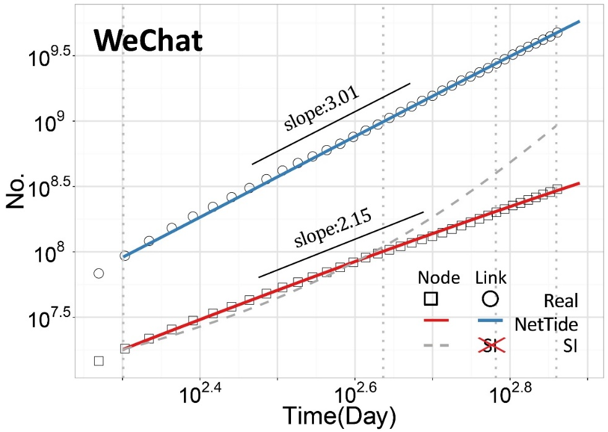
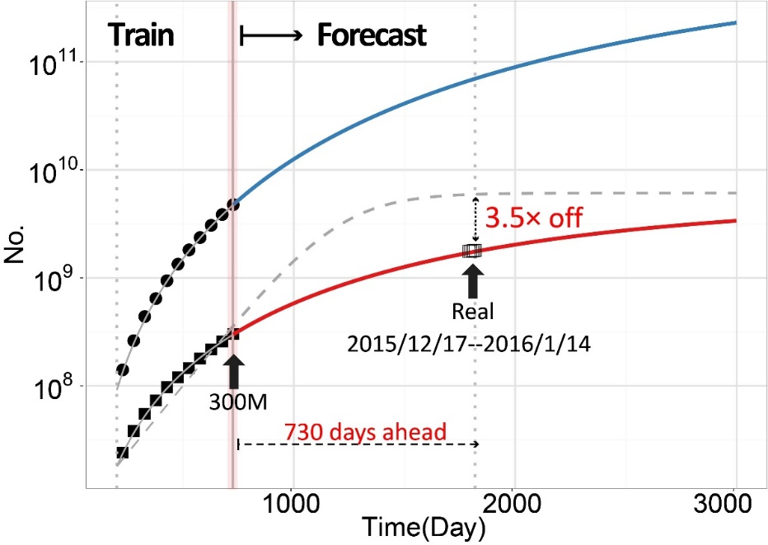
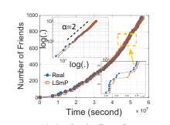
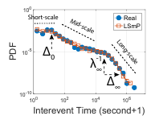
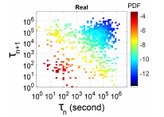
Introduction
Method
Experiments
Conclusion
Long Short Memory Process: Modeling Growth Dynamics of Microscopic Social Connectivity
Thanks
Chengxi Zang calvin-zcx@qq.com

