Slide 1
Quantifying Structural Patterns of Information Cascades
Chengxi Zang, Peng Cui, Chaoming Song, Christos Faloutsos, and Wenwu Zhu
zangcx13@mails.tsinghua.edu.cn, chaomingsong@gmail.com, christos@cs.cmu.edu,
{cuip, wwzhu}@tsinghua.edu.cn

Slide 2
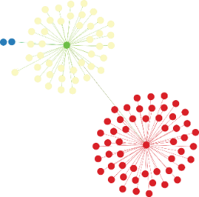
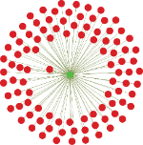
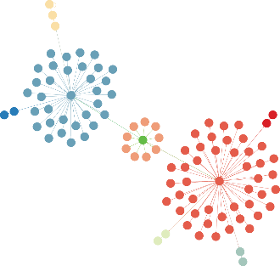
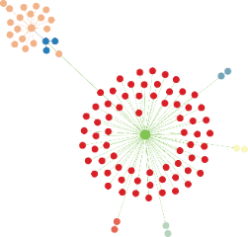
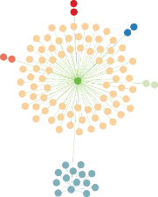
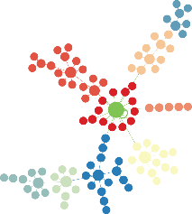
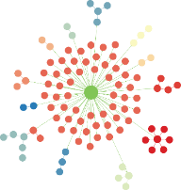
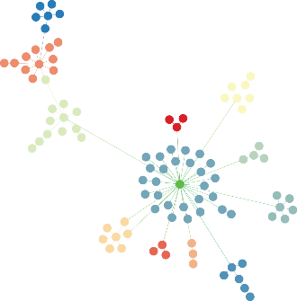
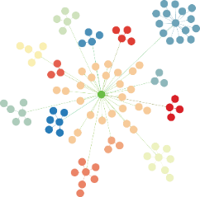
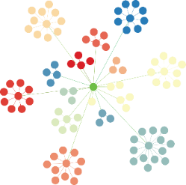
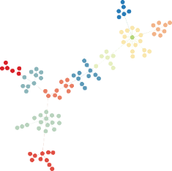
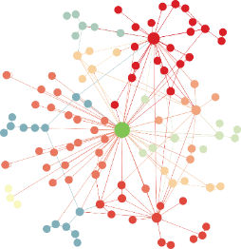
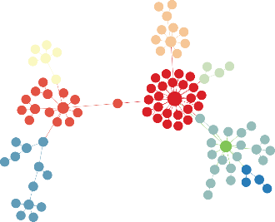
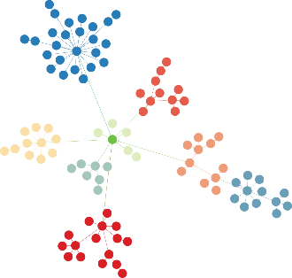
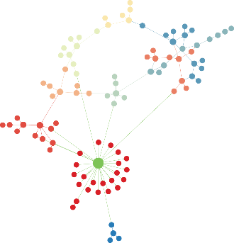
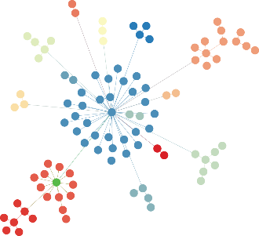
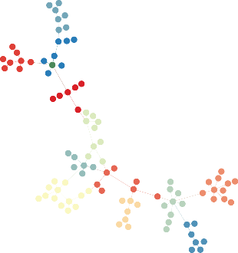
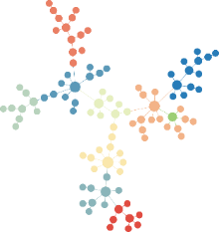
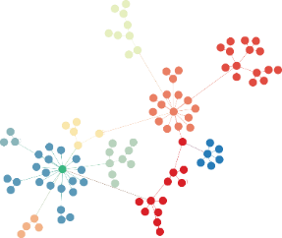
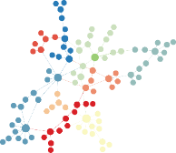
Real Information Cascades exhibit rich structures
Findings:
Structural complexity of information cascades is far beyond the previous conjectures: e.g., Star-like, narrow-and-deep-like, etc.
2

Slide 3
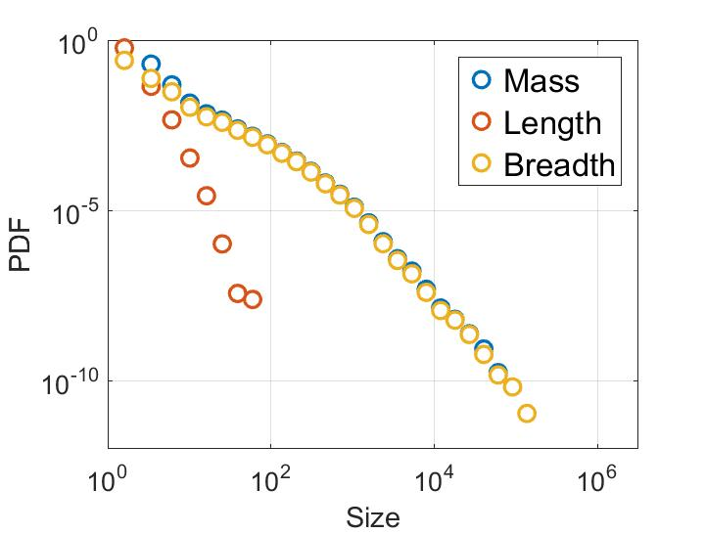
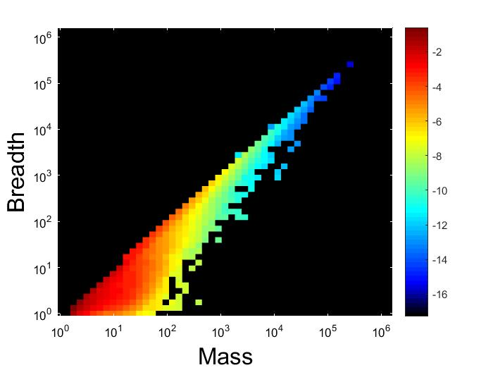
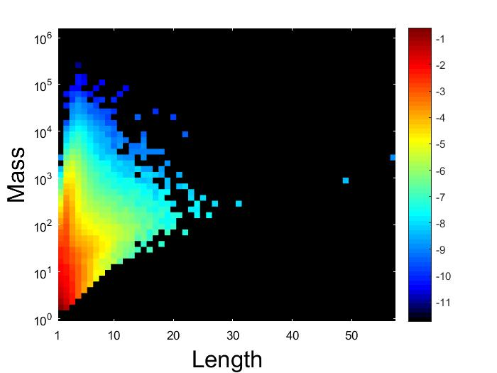
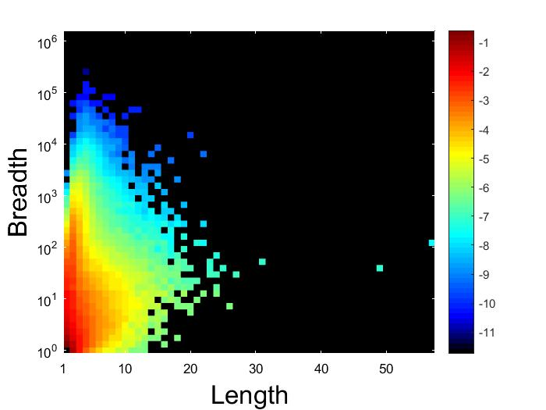
Information Cascades in Size Metric Space
Size Metrics
Dataset : Tencent Weibo
432 million cascades 101 million users, 7-day-period
full scale, explicit spreading traces
Findings:
Fat-tailed nature
Large cascades are either deep or wide.
Majority of cascades are wide and shallow.
There exist narrow and deep cascades.
No wide and deep, or very narrow and deep cascades.
Mass
Length
(a) Size
(b) Mass-Breadth
Breadth
(c) Length-Mass
(d) Length-Breadth
3

Slide 4
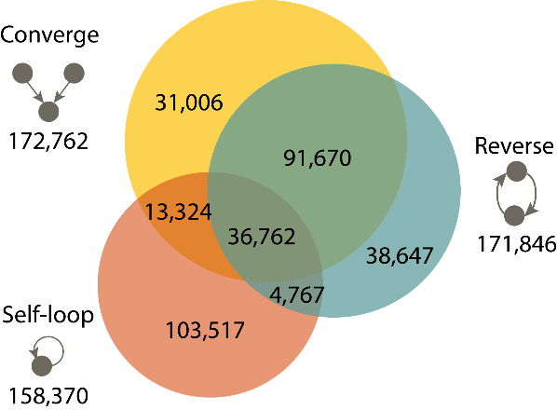
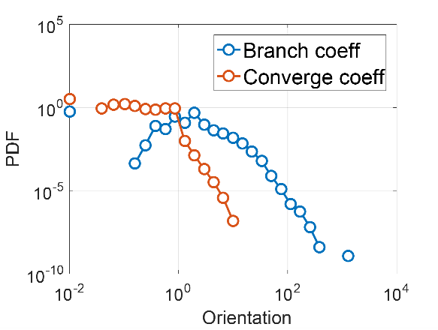
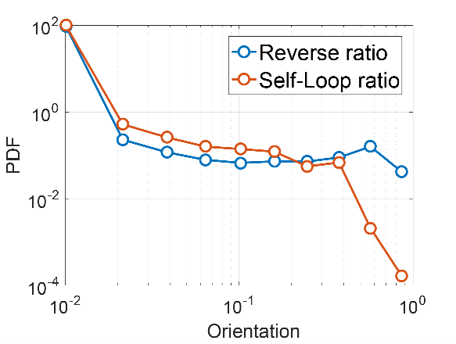
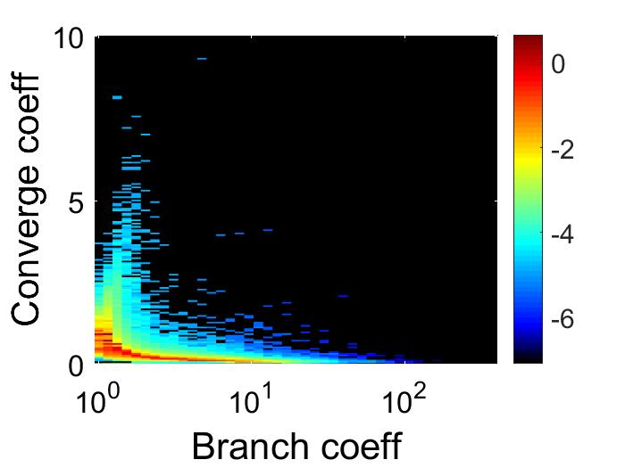
Information Cascades in Orientation Metric Space
Orientation
Metrics
Findings:
Converge, reverse and self-loop orientations are ubiquitous.
Bimodal distribution for branch orientation.
Down-stair-distribution for converge, reverse and self-loop orientations.
Extreme cases: each node has a self-loop edge, each edge has a reverse edge.
Non-coexistence relationship between branch and converge orientations.
C
Branch Coefficient
$$\frac{std(k_{out})}{<k_{in}>}$$
Converge Coefficient
$$\frac{std(k_{in})}{<k_{in}>}$$
Venn diagram of
converge reverse and self-loop
(b) Branch & Converge
Self-loop ratio
$$\frac{|\left\{u\right|\left(u,u\right)∈E\}|}{|V|}$$
Reverse ratio
$$\frac{\begin{aligned}|\left\{\left(u,v\right) \right|(u,v)∈E & \\ (v,u)∈E & u≠v\}|\end{aligned}}{|E|}$$
(c) Reverse & Self-loop
(d) Branch-Converge
4

Slide 5
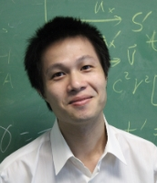
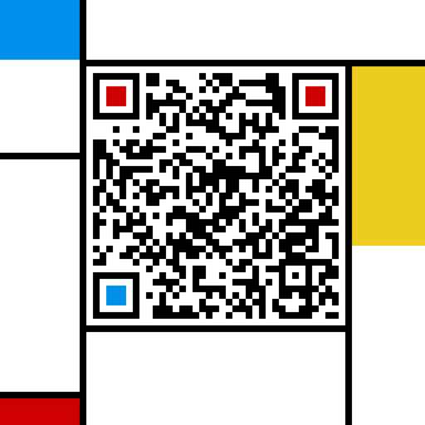
Thanks
Quantifying Structural Patterns of Information Cascades
Chengxi Zang
PengCui
Chaoming Song
Christos
Faloutsos
Wenwu Zhu
Chengxi Zang 臧承熙
Email: calvin-zcx@qq.com
WeChat：calvinzcx

