Slide 1
Learning and Interpreting Complex Distributions in Empirical Data
${Chengxi Zang}^{1}$, ${Peng Cui}^{1}$, ${Wenwu Zhu}^{1}$
${}^{1}$Tsinghua University
Notes:
Hi everyone, this is Chengxi Zang from Tsinghua Univ, Beijing, China. Thanks for coming. The title of today’s talk is …. This is a joint work with Peng Cui and Wenwu Zhu from Tsinghua U.

Slide 2
Introduction: Distribution Fitting for Decision Making
Introduction
Method
Experiments
Conclusion
Cross-Sectional Empirical Data
Distribution Fitting
For Uncertainty
Decision
Making
Quality of Apples
Selling Price
Expected Income
etc.
Notes:
Let me first introduce the problem by a toy example about apples. In August, we harvested tons of apples. In order to determine their quality, and then their prices and the money we will get this year, we collect data by measuring the weight of each apple. We use a parametric distribution, possibly a normal distribution, to model our collected data. It is this distribution that supports our decision making process, such as to evaluate the quality of apples, selling prices, expected income and so on. Put this in a mathematical way: at a specific time point t, we collect data, and then fit them by some parametric distributions to model the uncertainty of apples and to make informed business decisions. Different distributions may lead to different business decisions. Thus, our first problem is can we fit these empirical data accurately?

Slide 3
Introduction: Growth Dynamics for Decision Making
Introduction
Method
Experiments
Conclusion
Cross-Sectional Empirical Data
Distribution Fitting
For Uncertainty
Growth Dynamics
Time-related Decision
Making
Quality of Apples
Selling Price
Expected Income
Future Income
Early Marketing
How grow
Notes:
We call these empirical data cross-sectional because we collect them at a specific time point, or it’s a snapshot of the growth progress of all the apples. Furthermore, other informed business decisions with respect to time, like to estimate future income 1 year ahead, what’s the best timing to harvest and when to market apples at early stage, which are all depend on our knowledge of how apples grow dynamically over time. However, sometimes it’s very difficult to observe and collect the whole growth data directly over a very long period of time. Thus, the second problem is Can we infer the growth dynamics only from these cross-sectional data.

Slide 4
The Problem
Introduction
Method
Experiments
Conclusion
To fit empirical data by parametric distributions
To interpret their generative dynamics from the distributions
Distribution
Fitting
Empirical Data
Generative Dynamics
Notes:
In summary, this paper tries to fit empirical data by parametric distributions, and then interpret their generative dynamics from these distributions. Let me visualize the problem: from empirical data to distribution fitting, and further to their generative dynamics. Actually, this is a common research paradigm to understand the underlying structure and dynamics of data in various disciplines . We emphasize that this is a common research paradigm in various disciplines. Let me show some examples.

Slide 5
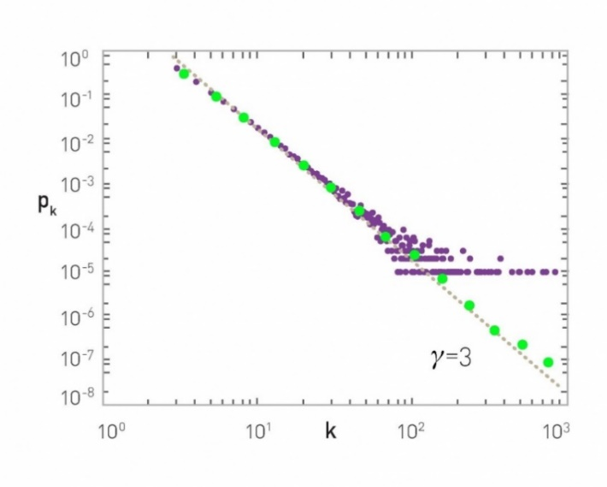
Example 1. Network Science
Introduction
Method
Experiments
Conclusion
Network data
Distribution Fitting
Growth Dynamics
Richer-get-richer
Preferential attachment
Matthew effect
Notes:
The first example is from Network Science discipline. For example, by investigating the degree distribution of this complex network, the physicists found power law distribution for degree, and then they found complex network evolves according to some dynamic rules, such as rich-get-richer dynamics. This research paradigm, namely empirical data, to distribution fitting, to generative dynamics, lifts the curtain on complex network studies.

Slide 6
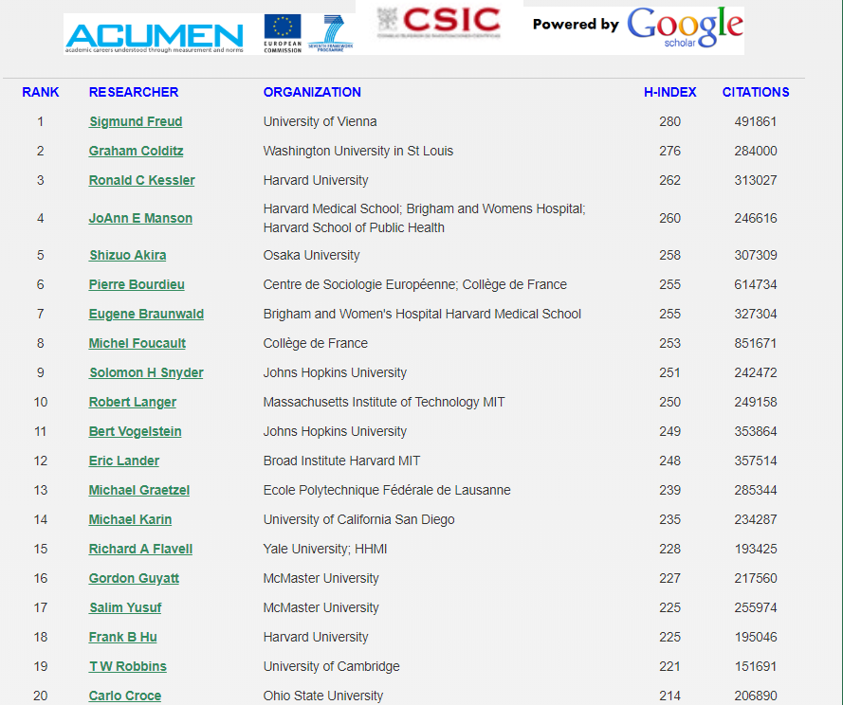
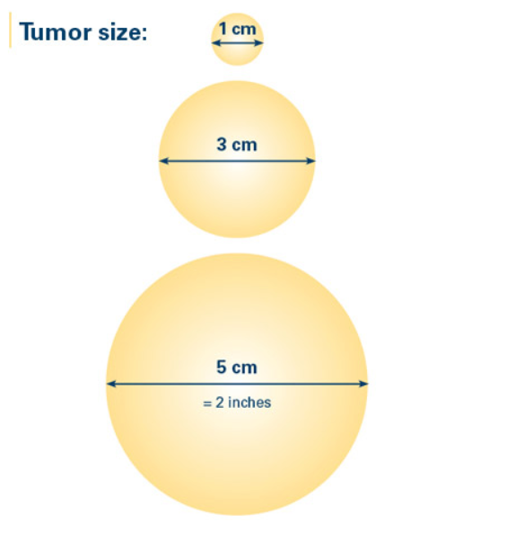
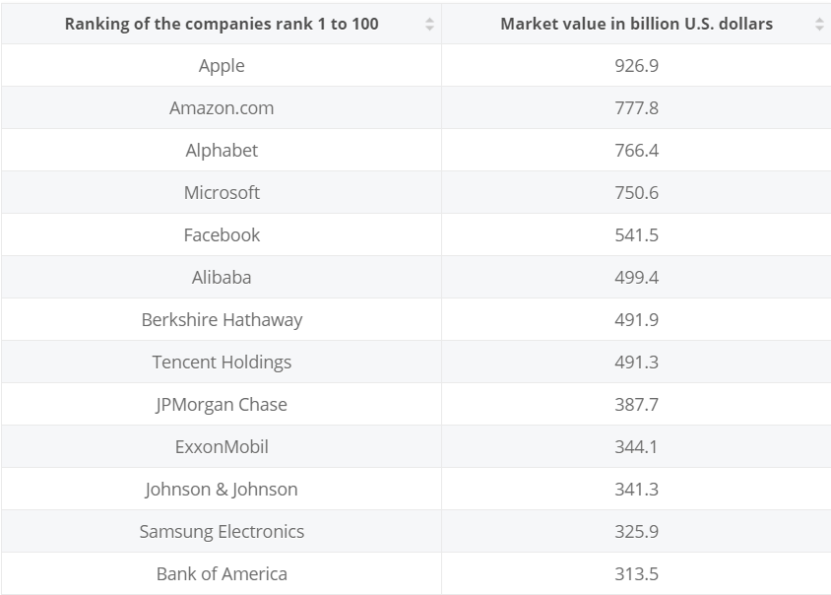
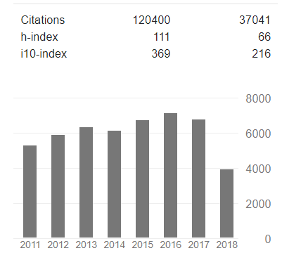
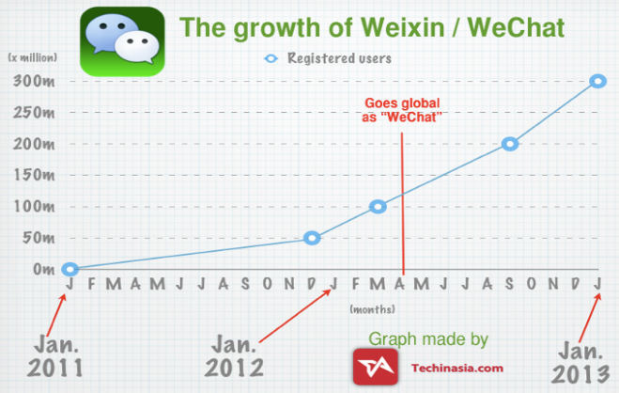
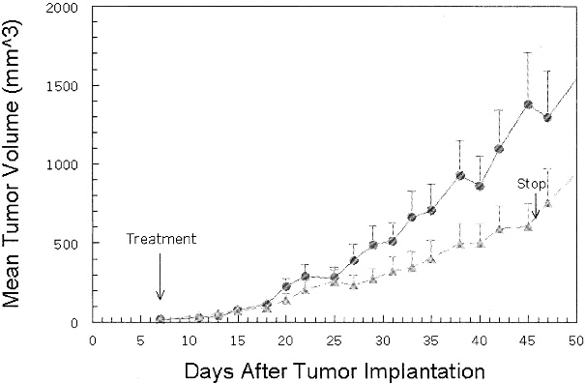
Example 1 cont.
Introduction
Method
Experiments
Conclusion
Citations
Market Values
Tumor Size
Citation Growth of Einstein
Growth of WeChat SN
Growth of Tumor
?
?
?
Notes:
Actually, the degree distribution can be replaced by the distribution of citation of scholars at present, distribution of market values of companies, and even size distribution of tumors for a specific cancer. Furthermore, from the distribution of the citations of scholars, Can we know how the career of a scholar take off over time?
From the distribution of market values, can we know how companies grow their values over time?
From the distribution of tumor size, can we know how the tumor develop over time? All these scenarios are to fit empirical data distributions, and then find their growth dynamics.
http://www.webometrics.info/en/node/58
https://www.breastcancer.org/symptoms/diagnosis/size

Slide 7
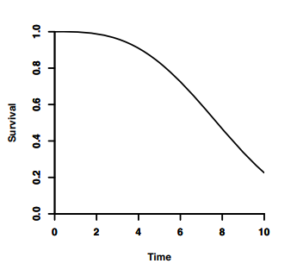
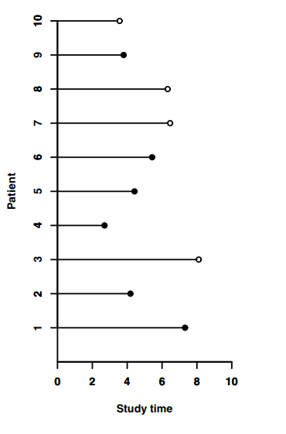
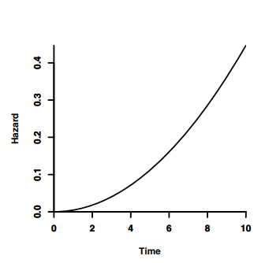
Example 2. Survival Analysis
Introduction
Method
Experiments
Conclusion
Distribution Fitting
Time to Event Data
Growth Risks of Diseases
Notes:
The second example is the survival analysis in statistics, which is one of the most widely used tools for biology and health. By collecting time-to-event data, for example, the time to death, the time to admission to a hospital, and so on. we can fit this time-2-event data and then understand how the risks of disease develop over time. empirical time-2-event data, to distribution fitting, to generative dynamics of diseases.

Slide 8
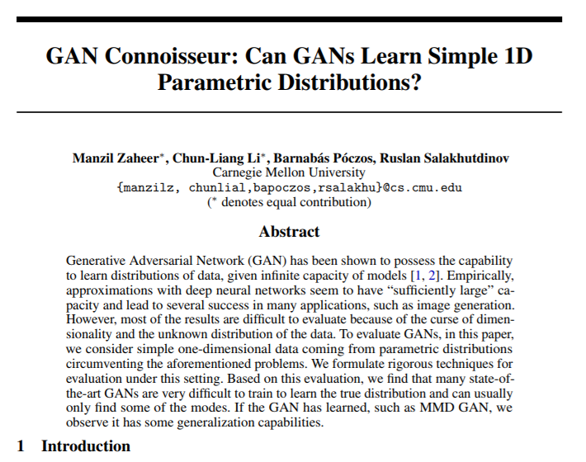
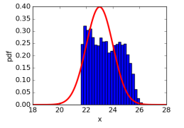
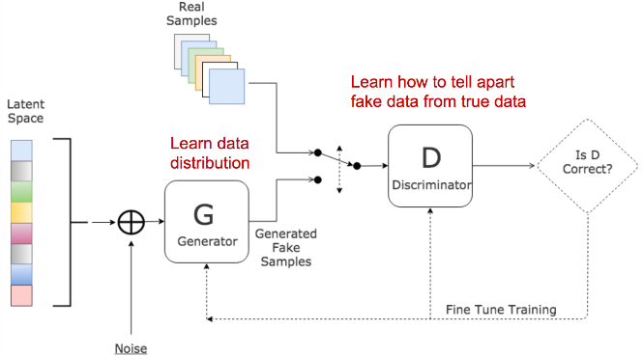
Example 3. Computer Science – Deep Model
Introduction
Method
Experiments
Conclusion
Data from Arbitrary Distribution
Generative Dynamics of Deep Model
Distribution Fitting by GAN
Notes:
The third example. Deep models are powerful tools due to their capability of fitting complex data, like image, sounds, and text. Some fundamental questions are if deep models, like GAN, can capture data generated from a well-defined distribution? and How do the deep models indeed generate them? empirical data, to distribution fitting, to generative dynamics of deep models

Slide 9
The Problem Again
Introduction
Method
Experiments
Conclusion
To fit empirical data by parametric distributions
To interpret their generative dynamics from these distributions
Distribution
Fitting
Empirical Data
Generative Dynamics
Notes:
Please let me repeat the problem. This paper tries to fit empirical data distributions, and then interpret their generative dynamics from these distributions. As Illustrated by these three steps: empirical data, distribution fitting and generative dynamics. Actually, through examples as we mentioned above, we find these apples represent a lot of stuffs in the real world, like the degree of complex network, citation number, market value, tumor size, time-2-event, and so on.

Slide 10
Challenges
Introduction
Method
Experiments
Conclusion
Distribution
Fitting
Empirical Data
Generative Dynamics
1. Distributions of Empirical Data are always Complex.
2. Existing Distribution Fitting Models Cannot Capture Complex Empirical Data accurately.
3. How to Infer Generative Dynamics from Cross-sectional Distributions is largely unknown
Notes:
However, in order to fit empirical data and then infer their generative dynamics, we are confronted with three challenges according to these three steps. The 1st is: empirical data always exhibit complex distributions rather than simple ones. The 2nd is: existing distribution fitting models cannot capture complex empirical data well. The 3rd is: how to infer the generative dynamics from cross-sectional distribution is largely unknown. We’ll explain these three challenges one by one.

Slide 11
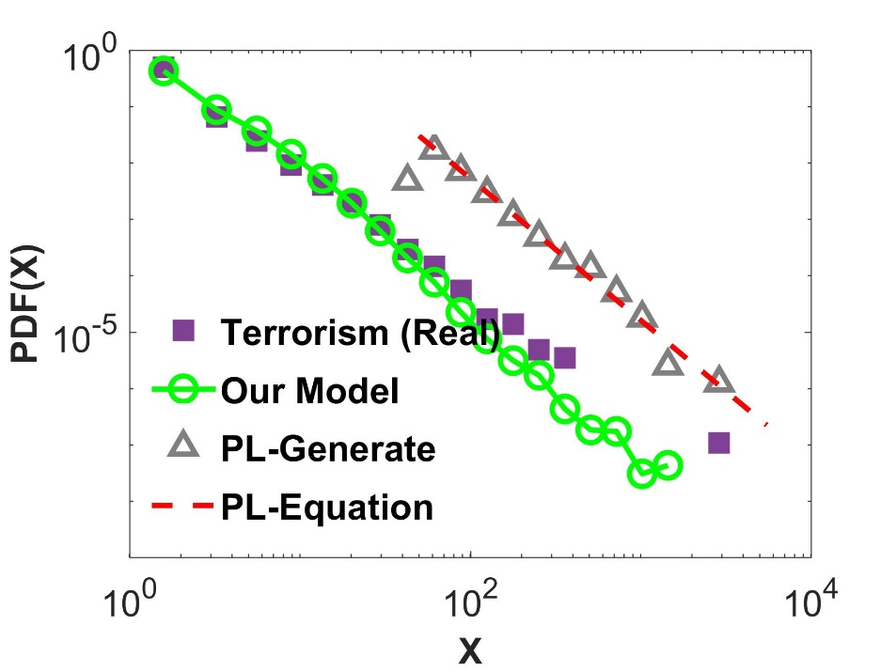
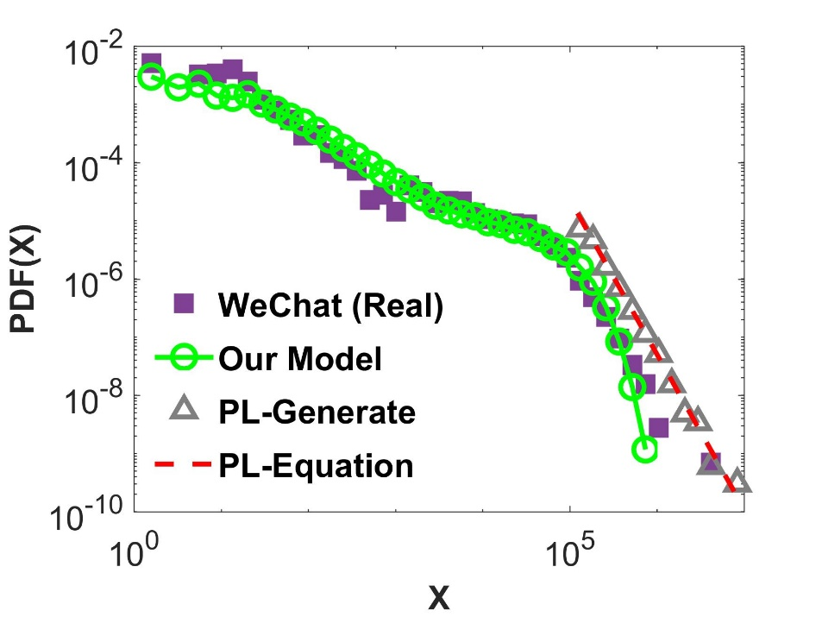
Challenges
Introduction
Method
Experiments
Conclusion
1. Distributions of Empirical Data are Complex.
1. Distributions of Empirical Data are Complex
Heavy tailed
Mixture model, multiscale complexities
Even for 1D
Terrorist attacks worldwide from 1968 to 2006
Inter-event-time of adding friends in WeChat by an active user
Notes:
The first challenges is: Distributions of Empirical Data are Complex. For example, we showcase 2 real-world datasets. One is the number of deaths by terrorist attacks worldwide from 1968 to 2006. Another is the inter-event-time of adding consecutive friends in WeChat by an active user. We plot the distributions on a log-log plot. We find heavy-tailed distributions rather than narrow-tailed ones like Gaussian distribution. What’s more, they are mixture models.

Slide 12
Challenges
Introduction
Method
Experiments
Conclusion
2. Existing Distribution Fitting Models Cannot Capture Complex Empirical Data Well.
2. Existing Distribution Fitting Models Cannot Capture Complex Empirical Data Well.
Narrow-tailed: Gaussian, Deep model GAN
Heavy-tailed : Power law, Weibull (or stretched exponential distribution) , …
Notes:
The second challenges is: Existing Distribution Fitting Models Cannot Capture Complex Empirical Data Well. For example, the Gaussian distribution is most widely used to fit narrow-tailed data distributions. Deep generative networks like GAN exhibit limited power in fitting 1-D parametric distributions [24]. A vast amount of literatures try to model the heavy-tailed data by power law distribution, Weibull distribution (or stretched exponential distribution) ,and so on. Specific mixture models are also used to fit complex distributions. Thus, can we have a unified and interpretable model to fit various complex distributions in the real world?
Zaheer, Manzil, et al. "GAN Connoisseur: Can GANs Learn Simple 1D Parametric Distributions?.“
Clauset, Aaron, Cosma Rohilla Shalizi, and Mark EJ Newman. "Power-law distributions in empirical data." SIAM review 51.4 (2009): 661-703.

Slide 13
Challenges
Introduction
Method
Experiments
Conclusion
3. How to Infer Generative Dynamics from Distributions is largely unknown.
3. How to Infer Generative Dynamics over Time from Cross-sectional Data?
From cross-sectional to longitudinal?
Output
?
Complex
Food, Ecological , Social, Biological, Technological …
Systems (Time)
Input
Notes:
The third challenges is: How to Infer Generative Dynamics from Distributions is largely unknown. Imagine empirical data are generated from a dynamic system shown in black box with some input signals. Can we give a mechanistic guess of what’s going on in this black box to explain the generative dynamics of the observed data? However, none of previous fitting methods try to interpret the longitudinal generative dynamics from cross-sectional distributions we observed.

Slide 14
Method Framework
Introduction
Method
Experiments
Conclusion
1. To build complex distributions by hazard rates in survival analysis.
2. To generate the distributions by a dynamic system.
3. To learn the distributions and the dynamic system from empirical data.
Distribution
1.
3.
2.
3.
3.
Data
2.
Survival Analysis
Dynamic System
Notes:
Facing the challenges as mentioned, we illustrate the framework of our method to solve the problem. There are three steps in total : First, we build complex distributions by hazard rates in survival analysis. Second, We show how to generate above distributions by a dynamic system. Third, we try to learn the distributions and the dynamic system from empirical data we observed. Let me explain to you 1 by 1.

Slide 15
Method Details: Step 1.
Introduction
Method
Experiments
Conclusion
1. To build complex distributions by hazard rates in survival analysis.
Random variable X with n observations
Tools for Distributions
PDF:
CDF:
Tools for Survival analysis
Survival function (CCDF):
Hazard function:
Distributions from hazard function:
Distribution
$$X, \{x_{1}, x_{2}, …, x_{n}\}$$
DETAILS
$f(x)$ = $\lim_{Δx→0}{\frac{Pr⁡(x≤X<x+∆x)}{∆x}}$
F$\left(x\right)= \int_{x_{0}}^{x}{f\left(s\right)ds}$
S$\left(x\right)=1 −F(x)$
Data
$λ(x)$= $\lim_{Δx→0}{\frac{\operatorname{Pr}\left(x≤X<x+∆x \right|X≥x)}{∆x}=\frac{f(x)}{S(x)}}$
Survival Analysis
Dynamic System
$$f\left(x\right)=λ(x)e^{−\int_{x_{0}}^{x}{λ\left(s\right)ds}}$$
Notes:
First step is to build complex distributions by hazard rates in survival analysis.
Suppose we care about random variable X and we have n observations. Tools to capture uncertainty and distributions are well-known pdf and cdf functions as defined in the box. Survival functions S(x) is the complementary CDF, and hazard function is defined as a conditional pdf. Here I will not elaborate on the physical meaning of the hazard function. What we need to know so far is: we can get a pdf for a specific distribution by transforming hazard function as the highlighted equation.

Slide 16
Step 1. Survival Analysis → Distribution
Introduction
Method
Experiments
Conclusion
$$f\left(x\right)=λ(x)e^{−\int_{x_{0}}^{x}{λ\left(s\right)ds}}$$
Examples:
Exponential distribution:
Power-law distribution:
$$λ\left(x\right)= β$$
$$f\left(x\right)= βe^{−βx}$$
$$λ\left(x\right)=\frac{α}{x}$$
$$f\left(x\right)= αx_{0}^{α}x^{−(α+1)}$$
Notes:
Let me show two examples of this magic transformation.
If hazard function is a constant beta, then we can get an exponential distribution like this
If hazard function is alpha/x, then we can get a power law distribution with pdf as shown above

Slide 17
Step 1. Survival Analysis → Distribution
Introduction
Method
Experiments
Conclusion
$$f\left(x\right)=λ(x)e^{−\int_{x_{0}}^{x}{λ\left(s\right)ds}}$$
Examples:
Exponential distribution:
Power-law distribution:
We propose: What distribution(s)?
$$λ\left(x\right)= β$$
$$f\left(x\right)= βe^{−βx}$$
$$λ\left(x\right)=\frac{α}{x}$$
$$f\left(x\right)= αx_{0}^{α}x^{−(α+1)}$$
$$λ\left(x\right)= β+ \frac{α}{{(x+Δ)}^{−θ}}$$
Notes:
We find relatively simple hazard function can be transformed to more complex pdfs. We propose a hazard function as $β+ \frac{α}{{(x+Δ)}^{−θ}}$ . What are the corresponding distributions of this hazard function?

Slide 18
Step 1. Survival Analysis → Complex Distribution
Introduction
Method
Experiments
Conclusion
$$f\left(x\right)=λ(x)e^{−\int_{x_{0}}^{x}{λ\left(s\right)ds}}$$
Examples:
Exponential distribution:
Power-law distribution:
We propose: What distribution(s)?
$$λ\left(x\right)= β$$
$$f\left(x\right)= βe^{−βx}$$
$$λ\left(x\right)=\frac{α}{x}$$
$$f\left(x\right)= αx_{0}^{α}x^{−(α+1)}$$
$$λ\left(x\right)= β+ \frac{α}{{(x+Δ)}^{−θ}}$$
Notes:
Surprisingly, by transforming this relatively simpler hazard function, with only four parameters, we can get a family of distributions, ranging from Gaussian, exponential, power law, Weibull (or named stretched exponential), to their complex combinatorial variants, as shown in the Table

Slide 19
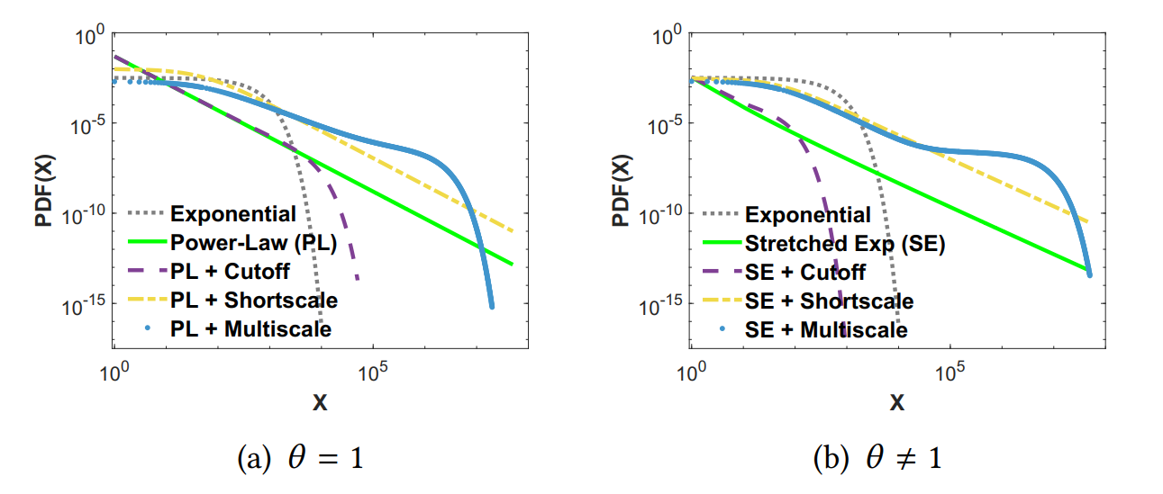
Step 1. Survival Analysis → Complex Distribution
Introduction
Method
Experiments
Conclusion
$$f\left(x\right)=λ(x)e^{−\int_{x_{0}}^{x}{λ\left(s\right)ds}}$$
Examples:
Exponential distribution:
Power-law distribution:
We propose: What distribution(s)?
$$λ\left(x\right)= β$$
$$f\left(x\right)= βe^{−βx}$$
$$λ\left(x\right)=\frac{α}{x}$$
$$f\left(x\right)= αx_{0}^{α}x^{−(α+1)}$$
$$λ\left(x\right)= β+ \frac{α}{{(x+Δ)}^{−θ}}$$
Notes:
We illustrate these distributions in these Figures, including simple distributions like exponential to complex distributions taking on multi-scale complexities on a log-log plot, over 6 order of magnitude.

Slide 20
Method Details: Step 2.
Introduction
Method
Experiments
Conclusion
2. To generate above distributions by a dynamic system.
Sketch of the System:
Distribution
Simple input:
Dynamic Systems
Data
Survival Analysis
Dynamic System
Complex output:
$$λ\left(x\right)= β+ \frac{α}{{(x+Δ)}^{−θ}}$$
Notes:
The second step is to generate above distributions by a dynamic system. The intuition behind our model is as follows: we view these complex distributions as being generated from a dynamic system, which takes same signals as input. Rather than modeling the complex outputs directly, namely various distributions, in a case-by-case way, we try to capture their unified generative dynamics. In short, we try to model the relatively simple generative dynamics which may generate complex phenomena.

Slide 21
Method Details: Step 2.
Introduction
Method
Experiments
Conclusion
2. To generate above distributions by a dynamic system.
Sketch of the System:
Input: A new agent $i$comes to the system following a Poisson Process at $t_{i}$.
Dynamics: The state of agent $i,$denoted as $x_{i}(t)$ grows over time according to the diﬀerential equation $\frac{dx_{i}(t)}{dt}=\frac{{(x_{i}\left(t\right)+Δ)}^{θ}}{β{(x_{i}\left(t\right)+Δ)}^{θ}t+ αt}$, with initial state $x_{i}\left(0\right)$.
Output: A cross-sectional observation of this system at time $t$, namely $\{x_{1}(t), x_{2}(t), …, x_{n}(t)\}$ follows distributions specified by this hazard function.
Distribution
Data
Survival Analysis
Dynamic System
$$λ\left(x\right)= β+ \frac{α}{{(x+Δ)}^{−θ}}$$
Notes:
Here we show the sketch of the dynamic system.
The input:
Dynamics:
Output:

Slide 22
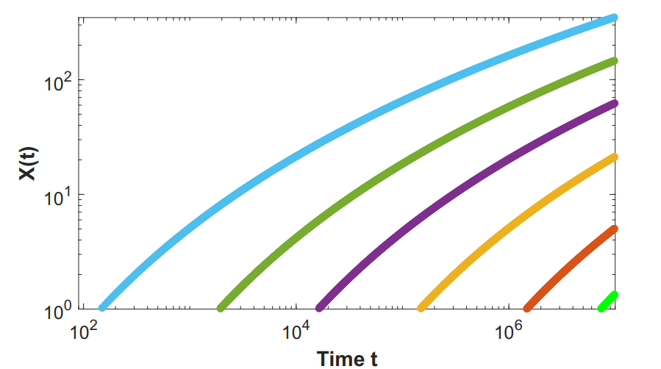
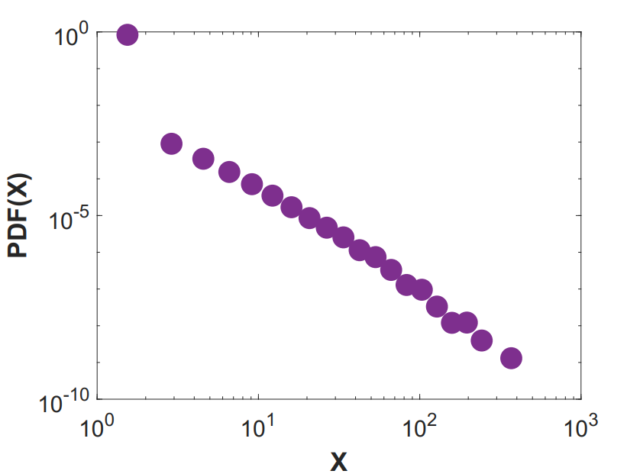
Method Details: Step 2.
Introduction
Method
Experiments
Conclusion
2. To generate above distributions by a dynamic system.
Sketch of the System:
Distribution
$$\frac{dx_{i}(t)}{dt}=\frac{{(x_{i}\left(t\right)+Δ)}^{θ}}{β{(x_{i}\left(t\right)+Δ)}^{θ}t+ αt}$$
Data
Survival Analysis
Dynamic System
$$λ\left(x\right)= β+ \frac{α}{{(x+Δ)}^{−θ}}$$
$$\frac{dx_{i}(t)}{dt}=\frac{{(x_{i}\left(t\right)+Δ)}^{θ}}{β{(x_{i}\left(t\right)+Δ)}^{θ}t+ αt}$$
Notes:
We illustrate the system by these two plots. Each agent comes to the system following a Poisson Process. The state of agent $i$grows over time according to this diﬀerential equation. A cross-sectional observation of this system at time $t$, namely $x_{i}(t)$follows various distributions specified by this hazard function. We can further interpret this differential equation: the rate of xi(t) is proportional to some non-linear transformation of x_i(t) itself, namely some rich-get-richer phenomena, over a function of time representing growing competition to slow down the growth rate.

Slide 23
Method Details: Step 3.
Introduction
Method
Experiments
Conclusion
3. To learn the distributions and the dynamic system from empirical data
Shared parameters in Distribution, Survival Analysis, and Dynamic System.
E.g. MLE in survival analysis / hazard rate space:
Construction and proof.
Optimization, Generator code @ www.calvinzang.com
Distribution
Data
Survival Analysis
Dynamic System
$$λ\left(x\right)= β+ \frac{α}{{(x+Δ)}^{−θ}}$$
$$\frac{dx_{i}(t)}{dt}=\frac{{(x_{i}\left(t\right)+Δ)}^{θ}}{β{(x_{i}\left(t\right)+Δ)}^{θ}t+ αt}$$
Notes:
At last, we try to learn the distributions and the dynamic system from empirical data. We find the distributions, the corresponding hazard function and the dynamics systems share same parameters. Thus, we can learn the parameters by one of them. Here we choose to learn the parameters by the maximum likelihood estimation (MLE) framework in survival analysis. We didn’t elaborate on the detailed proofs of the connections in this triangle. The optimization and generator codes can be found online.

Slide 24
Experiments - Data
Introduction
Method
Experiments
Conclusion
Cross-sectional observations
#words in novel Moby Dick
#deaths in terrorist attack
#mammals in earth
#people in the blackouts in the U.S.
#population of the U.S. cities
acre sizes of wildfires in the U.S.
Earthquake intensities in California
Degree of movie-actor network
Dynamics records of social behaviors
Time intervals of adding friends in WeChat social network
Time intervals of SMS by mobile users
Response time of Einstein’s correspondence
Response time of Freud’s correspondence
Time intervals of emails
Time intervals of information cascades in Tencent Weibo
Time intervals of group chatting in Tencent QQ
Time intervals of consecutive revision of one Wikipedia
Notes:
We validate our method by various synthetic and real-world datasets. Here, we only report the real-world data experiment. We validate the model by 16 real-world datasets from a variety of diﬀerent human endeavors. The first eight datasets are from cross-sectional observations. The last eight ones are from dynamic records on human or social dynamics. We compile and public all the datasets for reproducibility, among which the last eight datasets serve as the first data collection on human and social dynamics.

Slide 25
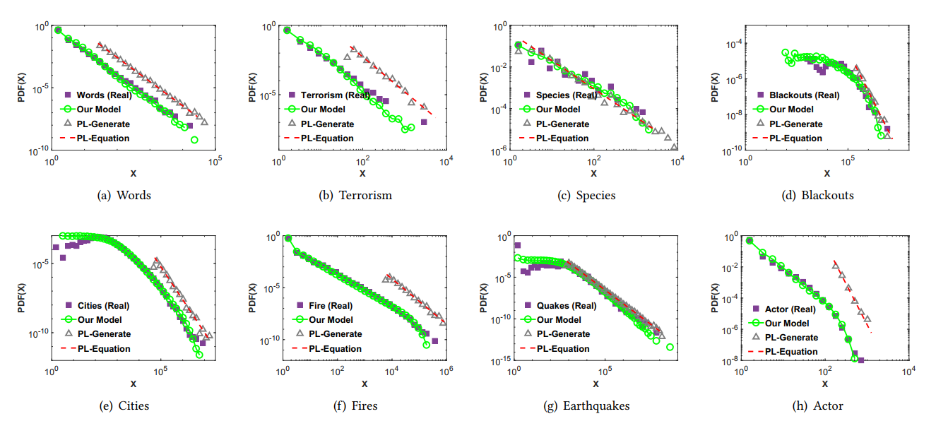
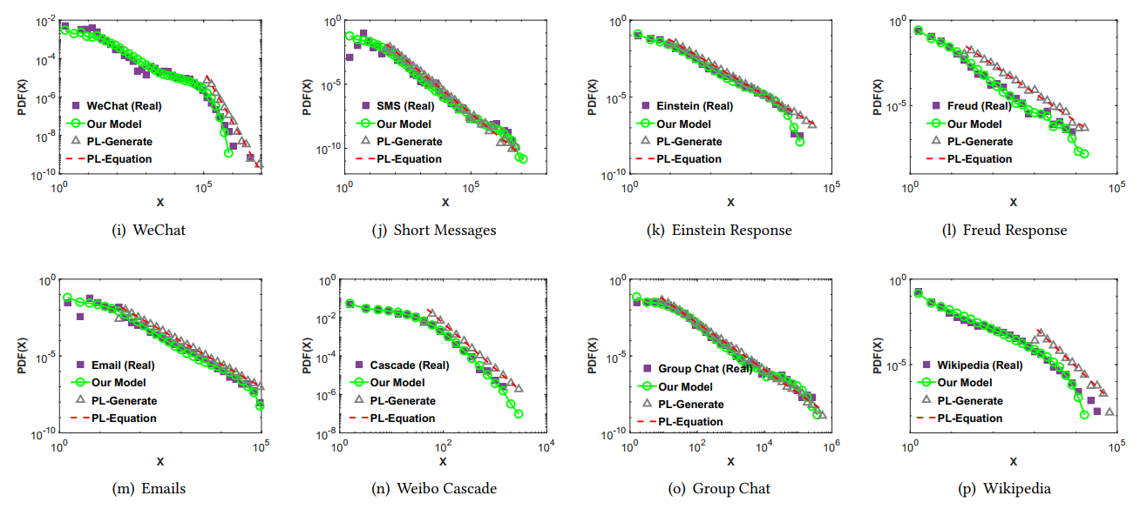
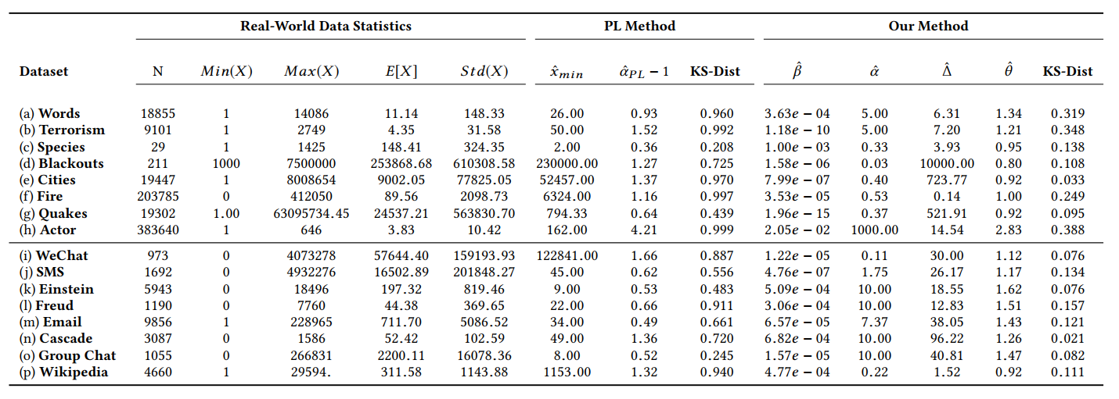
Experiments – Distribution Fitting
Introduction
Method
Experiments
Conclusion
Most widely used method
Systematic bias v.s. Good fitting
Notes:
Here we only show the experiments on real-world datasets. Here we plot the distributions of 16 datasets in purple, and fit them by our fitting method in green. We find empirical data exhibits various complex distributions and our method fits them well. However, we further illustrate one of the most widely used method to fit them as shown in gray. We find systematic biases by this method through visual inspection and statistical test of goodness of fit. Existing Distribution Fitting Models Cannot Capture Complex Empirical Data we observed.
Deep methods

Slide 26
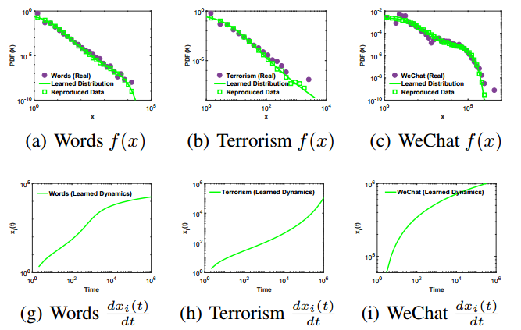
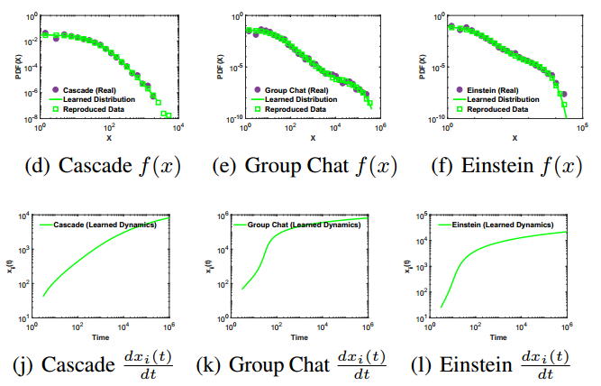
Experiments – Inferring Growth Dynamics
Introduction
Method
Experiments
Conclusion
Recap: Generating distributions by a dynamic system.
Sketch of the System:
Empirical Dynamics
$$\frac{dx_{i}(t)}{dt}$$
Empirical Dynamics
Notes:
We further showcase the generative growth dynamics we learned from this system. The dynamic system is: Each agent comes to the system following poisson process, changing their states according to the learned dynamics, and then a cross-sectional observation follows the observed distribution. We try to learn this dynamics from empirical data. For example, in the novel Moby Dick by Herman Melville, each word comes to the draft and changes their number of occurrence by this growth dynamics, at the end of the book we observe The number of occurrence of words in the novel follows above distribution.

Slide 27
Conclusions
Introduction
Method
Experiments
Conclusion
Tools for Fitting Complex Empirical Distributions
Leveraging survival analysis
A Generative Interpretation in a Dynamic System view
Cross-section → Longitudinal
One Framework of Connecting these Dots
Future works
More complex parametric distributions
Dynamics from Non-parametric distributions
Generative Dynamics, Physical meanings of existing distributions, Validations
Code & Data @ www.calvinzang.com
Distribution
Data
Survival Analysis
Dynamic System
$$λ\left(x\right)= β+ \frac{α}{{(x+Δ)}^{−θ}}$$
$$\frac{dx_{i}(t)}{dt}=\frac{{(x_{i}\left(t\right)+Δ)}^{θ}}{β{(x_{i}\left(t\right)+Δ)}^{θ}t+ αt}$$
Notes:
We conclude our work Learning and Interpreting Complex Distributions in Empirical Data here:
We develop parametric tools to fit various complex empirical distributions by leveraging a unified and simple hazard function in survival analysis. We then give a generative interpretation of the data in a dynamic system view. In a word, we try to connect the dots as shown in the plot. Possible further works are: we can construct more complex distributions by our framework, we can infer dynamics from non-parametric distribution models, and by applying this framework, we can further investigate the generative dynamics of existing distribution and empirical datasets. Codes and datasets will be found on my website later.

Slide 28
Thanks & QA
Learning and Interpreting Complex Distributions in Empirical Data
Distribution
${Chengxi Zang}^{1}$, ${Peng Cui}^{1}$, ${Wenwu Zhu}^{1}$
${}^{1}$Tsinghua University
Data
Survival Analysis
Dynamic System
$$λ\left(x\right)= β+ \frac{α}{{(x+Δ)}^{−θ}}$$
$$\frac{dx_{i}(t)}{dt}=\frac{{(x_{i}\left(t\right)+Δ)}^{θ}}{β{(x_{i}\left(t\right)+Δ)}^{θ}t+ αt}$$
www.calvinzang.com
Notes:
Cheers, Time for questions?

