Slide 1
Differential Deep Learning on Graphs and its Applications
Chengxi Zang and Fei Wang
Weill Cornell Medicine
www.calvinzang.com

Slide 2
This Tutorial
www.calvinzang.com/DDLG_AAAI_2020.html
AAAI-2020
Friday, February 7, 2020, 2:00 PM -6:00 PM
Sutton North, Hilton New York Midtown, NYC

Slide 3
Differential Deep Learning on Graphs
Graphs and Differential Equations are general tools to describe structures and dynamics of complex systems
Notes:
Graphs/networks
Differential Equations, difference equations etc.

Slide 4
Graph
Linked objects: nodes + edges
Network
Node
Edge

Slide 5
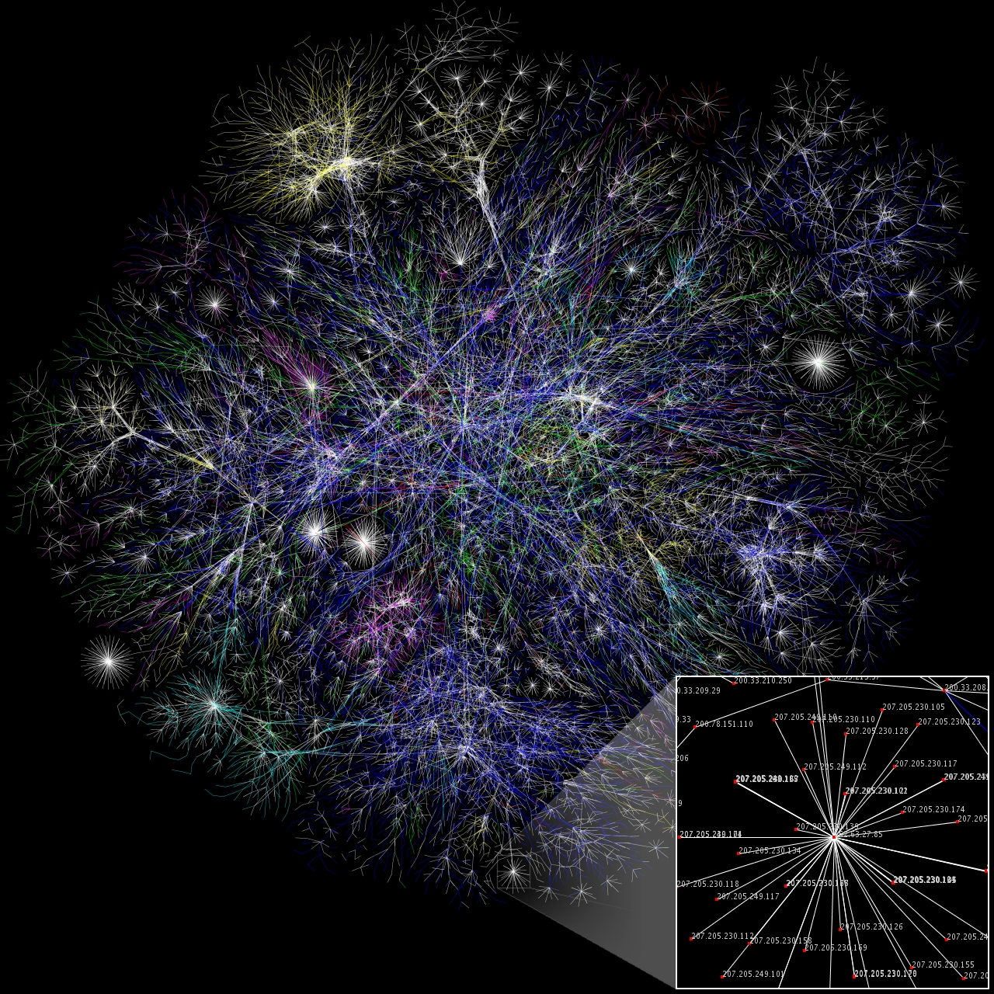
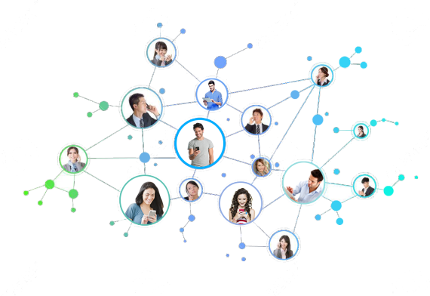
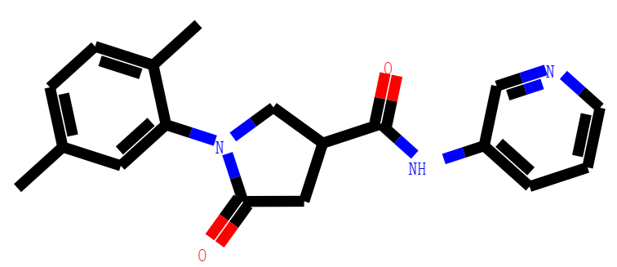
Graph
Node
Linked objects: nodes + edges
E.g.: Internet, social networks, molecules, etc.
Edge
Node: IPs, Edge: Hyperlinks
Node: users, Edge: Social links
Node: Atoms, Edge: Bonds
Internet Images from https://en.wikipedia.org/wiki/Network_theory
Notes:
https://en.wikipedia.org/wiki/Network_theory

Slide 6
Differential Equations
Equations which relates functions (physical quantities) and their derivatives (rates of change), e.g.
e.g.Population growth
Exponential growth: $\frac{dx}{dt}=ax$ → $x(t)=Ce^{at}$ solution by integrating
Power-law growth: $\frac{dx}{dt}=a\frac{x}{t}$ → $x(t)=Ct^{a}$ solution by integrating
Notes:
The study of differential equations consists mainly of the study of their solutions (the set of functions that satisfy the equation), and of the properties of their solutions. Only the simplest differential equations are solvable by explicit formulas; however, many properties of solutions of a given differential equation may be determined without computing them exactly.

Slide 7
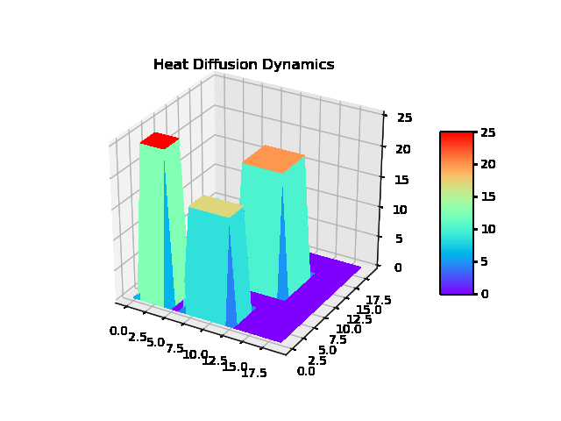
Differential Equations
Equations which relates functions (physical quantities) and their derivatives (rates of change), e.g.
e.g.Population growth
Exponential growth: $\frac{dx}{dt}=ax$ → $x(t)=Ce^{at}$ solution by integrating
Power-law growth: $\frac{dx}{dt}=a\frac{x}{t}$ → $x(t)=Ct^{a}$ solution by integrating
Differential Equation System
A system of differential equations
Newton’s law of cooling: $\frac{dX}{dt}=−kLX$
Laplacian matrix: L=D-A, A: adjacency matrix
Notes:
The study of differential equations consists mainly of the study of their solutions (the set of functions that satisfy the equation), and of the properties of their solutions. Only the simplest differential equations are solvable by explicit formulas; however, many properties of solutions of a given differential equation may be determined without computing them exactly.

Slide 8
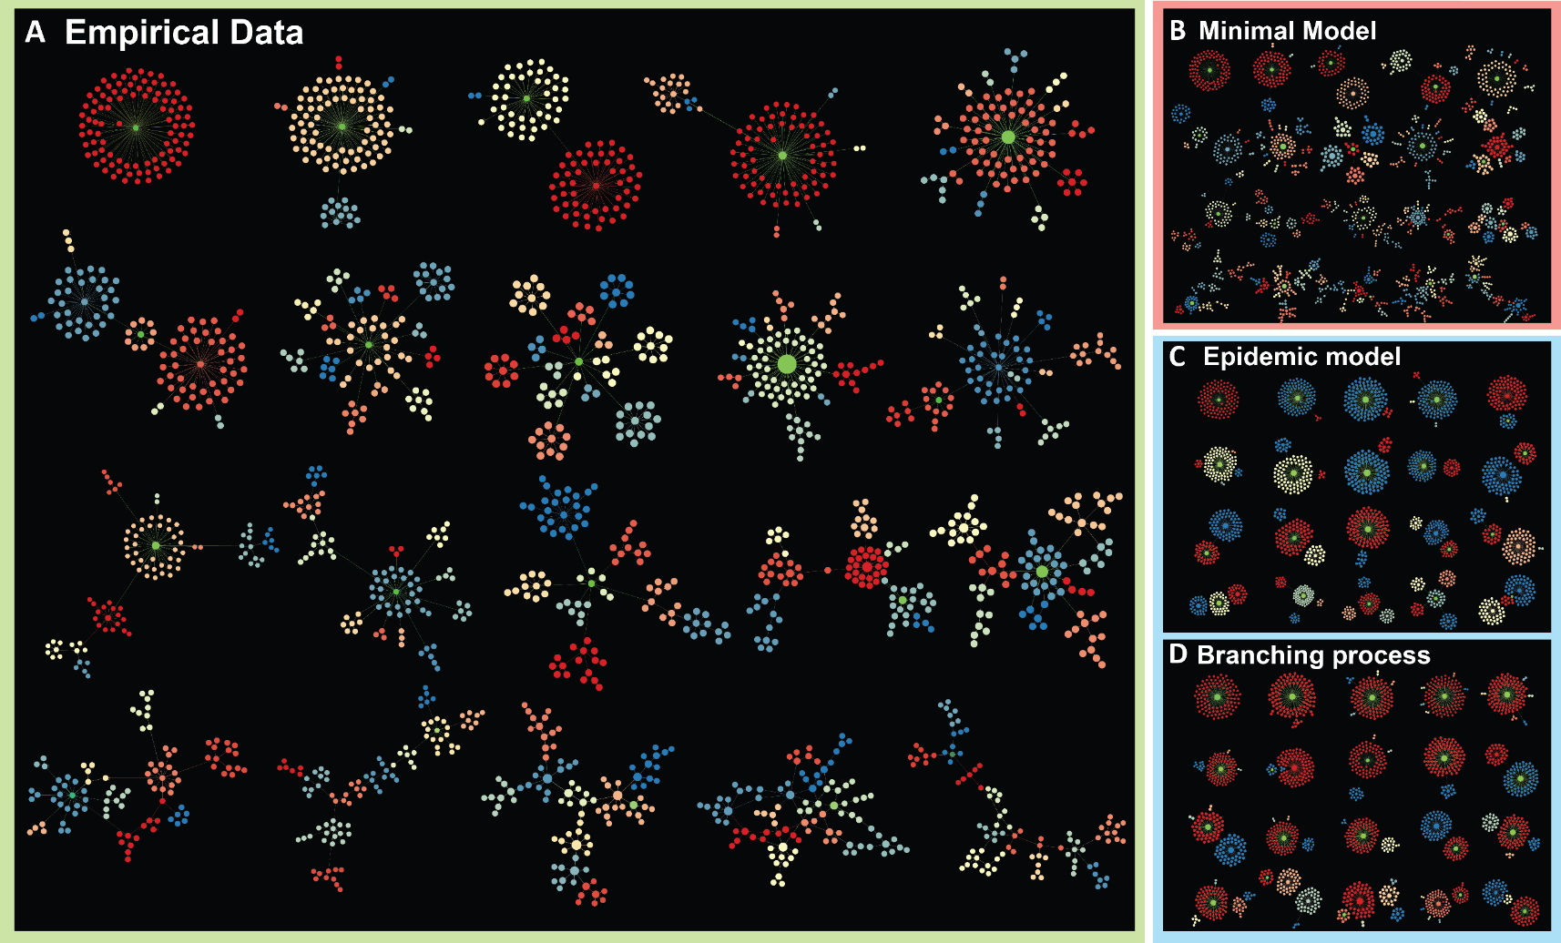
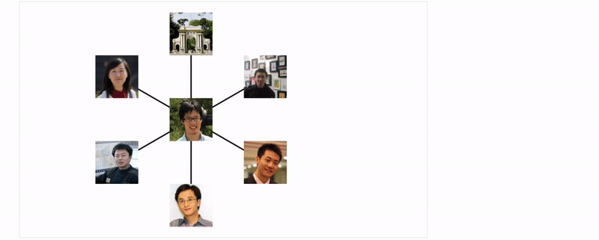
Why Graphs and Differential Equations?
Question (Social network analysis): How does information spread in social networks? How does information flow form complex structural patterns?
Image from: Zang et al. 2019. Uncovering Pattern Formation of Information Flow. KDD.

Slide 9
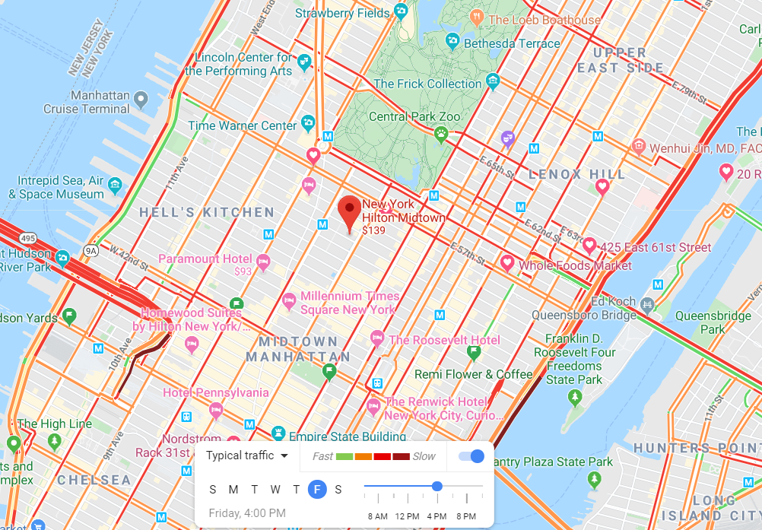
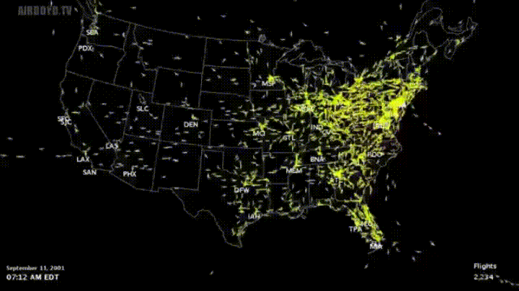
Why Graphs and Differential Equations?
Question (Urban computing): Can we predict and control traffic flows on road networks?

Slide 10
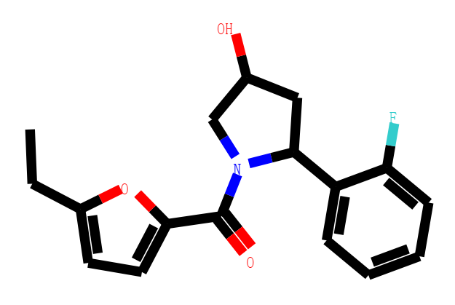
Why Graphs and Differential Equations?
Question (Drug discovery): Can we predict molecular properties? Can we design novel drug molecule with optimized properties?

Slide 11
Differential Deep Learning on Graphs
Graphs and Differential Equations are general tools to describe structures and dynamics of complex systems
Inspired by the differential equations, we can design and analyze deep models
Notes:
Graphs/networks
Differential Equations, difference equations etc.

Slide 12
Residual Net.→ Differential Equations
Plain Convolution Net.
Residual Net.
$$h_{t+1}=f(h_{t}, θ_{t})$$
$$h_{t+1}=h_{t}+f(h_{t}, θ_{t})$$
$$h_{t}$$
$$h_{t}$$
$$f(h_{t}, θ_{t})$$
Conv
Conv
$$f(h_{t}, θ_{t})$$
ReLU
ReLU
$$×δ=1$$
$$h_{t+1}$$
$$+$$
He et al. 2016. Identity mappings in deep residual networks ECCV.
$$h_{t+1}$$

Slide 13
Residual Net.→ Differential Equations
Plain Convolution Net.
Residual Net.
Differential Equation Net.
$$h_{t+δ}=h_{t}+\int_{t}^{t+δ}{f(h, θ,τ)}dτ$$
$$h_{t+1}=f(h_{t}, θ_{t})$$
$$h_{t+1}=h_{t}+f(h_{t}, θ_{t})$$
$$\frac{h_{t+1}−h_{t}}{δ}=f\left(h_{t}, θ_{t}\right), δ=1$$
$$\frac{dh_{t}}{dt}=f\left(h_{t}, θ_{t}\right)$$
$$h_{t}$$
$$h_{t}$$
$$h_{t}$$
$$f(h_{t}, θ_{t})$$
$$f(h_{t}, θ_{t})$$
Conv
Conv
Conv
$$f(h_{t}, θ_{t})$$
ReLU
ReLU
ReLU
$$×δ=1$$
$$×δ→0^{+}$$
$$+$$
$$\int_{t}^{t+δ}{}$$
$$h_{t+1}$$
$$+$$
Chen et al. 2019. Neural Ordinary Differential Equations. NeurIPS.
$$h_{t+1}$$
$$h_{t+δ}$$

Slide 14
RNN → Differential Equations
RNN
Residual RNN
$$h_{t}=f\left(h_{t−1}, x_{t},θ_{t}\right)$$
$$h_{t}=h_{t−1}+f\left(h_{t−1}, x_{t},θ_{t}\right)$$
$$y_{t}=o\left(h_{t}, w_{t}\right)$$
$$y_{t}=o\left(h_{t}, w_{t}\right)$$
$$y_{t}$$
$$y_{t}$$
Output
Output
$$f(h_{t}, x_{t},θ_{t})$$
$$f(h_{t}, x_{t},θ_{t})$$
ReLU
$$×δ=1$$
ReLU
$$+$$
$$h_{t−1}$$
Weight
$$h_{t}$$
$$h_{t−1}$$
$$h_{t}$$
Weight
$$x_{t}$$
$$x_{t}$$

Slide 15
RNN → Differential Equations
RNN
Residual RNN
Differential Equation RNN
$$h_{t}=h_{t−δ}+\int_{t−δ}^{t}{f(h, x,θ,τ)}dτ$$
$$h_{t}=f\left(h_{t−1}, x_{t},θ_{t}\right)$$
$$h_{t}=h_{t−1}+f\left(h_{t−1}, x_{t},θ_{t}\right)$$
$$y_{t}=o\left(h_{t}, w_{t}\right)$$
$\frac{h_{t}−h_{t−1}}{δ}=f\left(h_{t−1}, x_{t},θ_{t}\right)$, $δ$=1
$$\frac{dh_{t}}{dt}=f\left(h_{t}, x_{t},θ_{t}\right)$$
$$y_{t}$$
$$y_{t}=o\left(h_{t}, w_{t}\right)$$
$$y_{t}$$
$$y_{t}$$
$$y_{t}=o\left(h_{t}, w_{t}\right)$$
Output
Output
Output
$$f(h_{t}, x_{t},θ_{t})$$
$$f(h_{t}, x_{t},θ_{t})$$
$$f(h_{t}, x_{t},θ_{t})$$
ReLU
$$×δ=1$$
ReLU
ReLU
Weight
$$+$$
Weight
$$×δ→0^{+}$$
$$+$$
$$h_{t−1}$$
$$h_{t}$$
$$h_{t−1}$$
$$h_{t}$$
$$h_{t−δ}$$
$$h_{t}$$
Weight
$$x_{t}$$
$$\int_{t}^{t+δ}{}$$
$$x_{t}$$
$$x_{t}$$
Pearlmutter1995. Gradient calculations for dynamic recurrent neural networks: A survey. TNN.

Slide 16
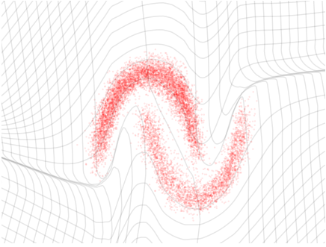
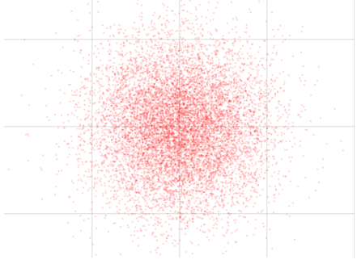
Normalizing flow→Differential Equations
$P\left(X\right)$:
Complex empirical distribution
An invertible generative model
Goal: $X\sim P\left(X\right)$
Inference:$Z=f_{θ}(X)$
From complex to simple
Generation:$X=f_{θ}^{−1}(Z)$
Generate complex by invertible mapping
$\log{P\left(X\right)=\log{P(Z)}+\log{|\det{(\frac{∂f_{θ}}{∂Z})}|}}$
Change of variable formula
Exact maximum likelihood training
Inference
Generation
$P\left(Z\right)$:
Simple latent distribution
Image from: Dinh et al. 2017. Density Estimation using Real NVP. ICLR.

Slide 17
Normalizing flow → Differential Equations
Flow
Inference:$Z_{t+1}=f_{θ}(Z_{t})$ , Generation:$Z_{t}=f_{θ}^{−1}(Z_{t+1})$
$\log{P\left(Z_{t}\right)=\log{P(Z_{t+1})}+\log{|\det{(\frac{∂f_{θ}}{∂Z})}|}}$
Residual Flow
Inference:$Z_{t+1}=Z_{t}+{δf}_{θ}\left(Z_{t}\right),$Generation:$Z_{t}={(I+δf_{θ})}^{−1} \left(Z_{t+1}\right),δ$=1
$\log{P_{M}\left(Z_{t}\right)=\log{P_{Z}(Z_{t+1})}+\log{|\det{(\frac{∂(I+δf_{θ})}{∂Z})}|}}$
Differential Eq. Flow
Inference:$\frac{dZ(t)}{dt}=f_{θ}\left(Z, t\right),$ Generation:$Z\left(0\right)=Z\left(t\right)−\int_{0}^{t}{f_{θ}(Z, τ)}dτ$
$\frac{d logP(Z(t))}{dt}=−tr(\frac{df}{dZ(t)})$
Chen et al. 2019. Neural Ordinary Differential Equations. NeurIPS.

Slide 18
An example: NICE v.s. Differential NICE
NICE or RealNVP
splitting dimensions + residual flow updated alternately
Split:
X$=\left(X_{1},X_{2}\right)$
$Z=(Z_{1},Z_{2})$
Add:
$Z_{1}=X_{1}$ (save information for reverse)
$Z_{2}=X_{2}+f_{θ}(X_{1})$ (Residual)
Reverse mapping:
$X_{1}=Z_{1}$
$X_{2}=Z_{2}−f_{θ}(Z_{1})$
Next layer by alternating update:
$Z_{1}=X_{1}+f_{θ}(X_{2})$ (Residual)
$Z_{2}=X_{2}$ (save information for reverse)
…
$$Z=(Z_{1},Z_{2})$$
$$f$$
Hamiltonian Systems
Add
CNN
$\left[\begin{matrix}\frac{dZ_{1}}{dt} \\ \frac{dZ_{2}}{dt}\end{matrix}\right]$=$\left[\begin{matrix}f_{θ}(Z_{2}) \\ f_{θ}(Z_{1})\end{matrix}\right]$
$×$L layers
$$X_{2}$$
$$X_{1}$$
Split
$$X=(X_{1},X_{2})$$
Dinh et al. 2014. Nice: Non-linear independent components estimation
Dinh et al. 2017. Density Estimation using Real NVP. ICLR.
Chen et al. 2019. Neural Ordinary Differential Equations. NeurIPS.

Slide 19
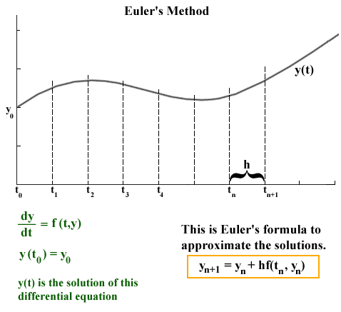
DEs → DNNS by Numerical Methods
Differential Equation Net.
Residual Net.
$$h_{t+δ}=h_{t}+\int_{t}^{t+δ}{f(h, θ,τ)}dτ$$
Numerical Methods:
Integrating DEs by discretization
$$h_{t+1}=h_{t}+f(h_{t}, θ_{t})$$
$$\frac{dh_{t}}{dt}=f\left(h_{t}, θ_{t}\right)$$
$$h_{t+1}=h_{t}+δf\left(h_{t}, θ_{t}\right), δ=1$$
output = input + step * rate of change
$$h_{t}$$
$$h_{t}$$
$$f(h_{t}, θ_{t})$$
$$f(h_{t}, θ_{t})$$
Conv
Conv
$$δ$$
ReLU
ReLU
$$h_{n+1}=h_{0}+\sum_{t=1}^{n}{δf\left(h_{t}, θ_{t}\right)}$$
$$×δ→0^{+}$$
$$×δ=1$$
$$+$$
$$\int_{t}^{t+δ}{}$$
$$+$$
Gif image from https://jmahaffy.sdsu.edu/courses/f00/math122/lectures/num_method_diff_equations/nummethod_diffeq.html
$$h_{t+δ}$$
$$h_{t+1}$$

Slide 20
Why Such Connections
Deep Learning → Differential Equations
Analysis
Math analysis tools
Concepts in dynamic system and control: stability, robustness, complexity, resilience, etc.
Modeling Continuous-time process
Physical meaning. The laws of nature are expressed as differential equations.
Differential Equations → Deep Learning
Design
There are many dynamical systems and differential equations.
Discretization of continuous time-varying neural dynamics → Deep Neural Networks
DNNs implemented by modern auto-differentiation softwares are more flexible, expressive and efficient
Generative models and Invertible structures
Notes:
Forward mapping → Forward integration
Forward integration → Forward mapping

Slide 21
Why Such Connections
Deep Learning → Differential Equations
Analysis
Math analysis tools
Concepts in dynamic system and control: stability, robustness, complexity, resilience, etc.
Modeling Continuous-time process
Physical meaning. The laws of nature are expressed as differential equations.
Differential Equations → Deep Learning
Design
There are many dynamical systems and differential equations.
Discretization of continuous time-varying dynamics → Deep Neural Networks
DNNs implemented by modern auto-differentiation softwares are more flexible, expressive and efficient
Generative models and Invertible structures
Notes:
Forward mapping → Forward integration
Forward integration → Forward mapping

Slide 22
Differential Deep Learning on Graphs
Graphs and Differential Equations are general tools to describe structures and dynamics of complex systems
Inspired by the Differential Equations, we can design and analyze Deep Models
For applications on graphs (our focus), including:
Molecular graph generation
Learning dynamics on graphs
Mechanism discovery
in a data-driven manner
Notes:
Graphs/networks
Differential Equations, difference equations etc.
区分 方法 和 应用
Molecular graph generation
Traffic prediction
Molecular Graph Generation
Learning dynamics of complex systems
Mechanism discovery

Slide 23
Molecular Graph Generation
Goal: To generate novel molecules with optimized properties
Graph Analysis tasks
Graph generation: $G \sim P(G)$
Graph property prediction: $f(G)$
Graph optimization: $G$→ $G′$ and $maximizing$ $f\left(G^{′}\right)−f(G)$
P ( ) ?
f ( )=?

Slide 24
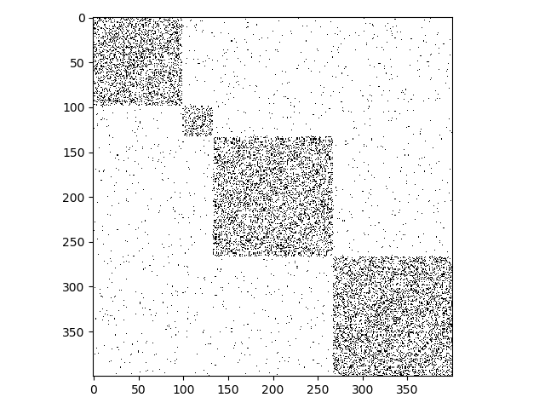
Learning Dynamics on Graphs
Goal: To predict temporal change or final states of complex systems
Graph Analysis tasks
Continuous-time network dynamics prediction $X(t)$
Structured sequence prediction $X[t+k]$
Node classification/regression $Y(X)$
Adjacency Matrix
+
Dynamic
Process
Dynamics of each nodes
Graph
?

Slide 25
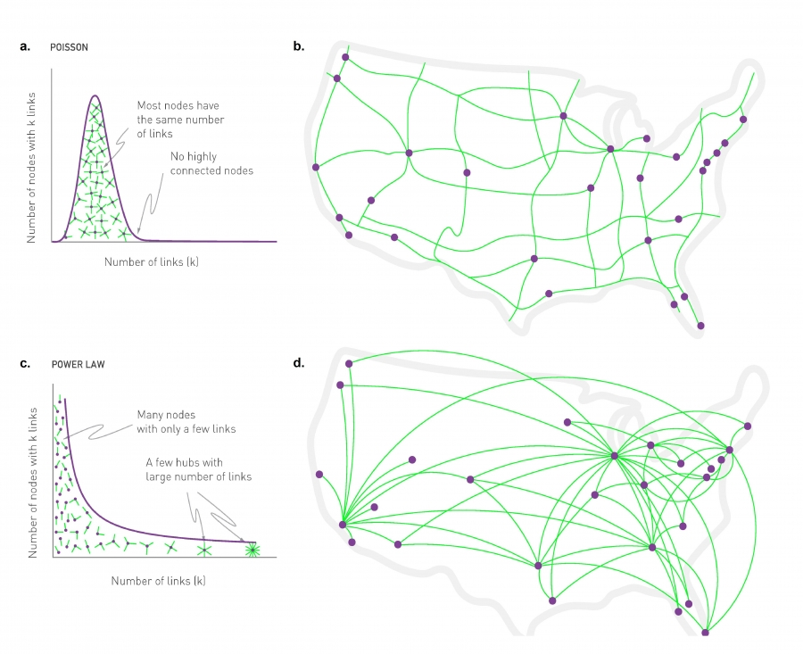
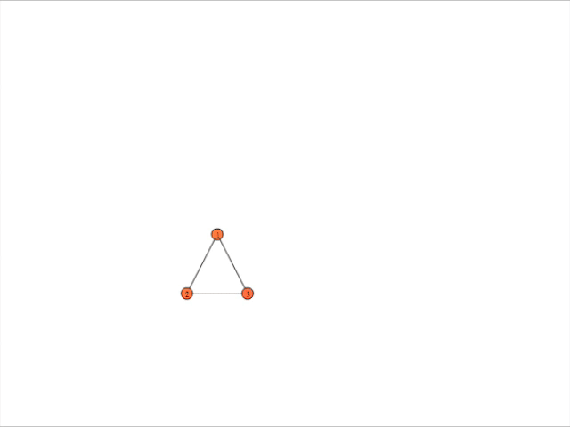
Mechanism Discovery
Goals: To find dynamical laws of complex systems
Graph Analysis tasks
Density estimation vs. mechanism discovery
Data-driven discovery of differential equations
?
$$\frac{dX}{dt}$$
Image from http://networksciencebook.com/chapter/4#hubs

Slide 26
Why Is It Hard?
Complex combinatorial structures of graphs
Due to complex combinations of node and edge sets
Nodes and edges can have multiple types
Node types: C, H, O, etc., Edge types: single, double, triple bond.
Complexity: the scale of drug-like graphs $\sim {10}^{60}$
Deep models are majorly designed for regular grid structures (image or text)
vs.

Slide 27
Why Is It Hard?
Encoding graph is hard, Decoding graph is much harder
Encoding, embedding, inference with graph input
Decoding, generation with graph output
E.g. Chemically valid molecular graphs
?
vec
$$f:G→ℝ^{d}$$
$$ℝ^{d}$$
?
vec
$f:ℝ^{d}→$ $G$
$$ℝ^{d}$$
Notes:
To generate combinatorial structure with chemical validity

Slide 28
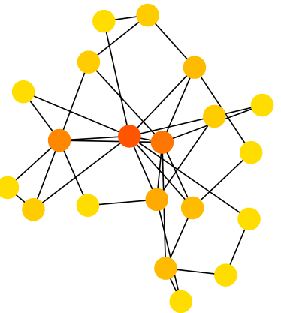
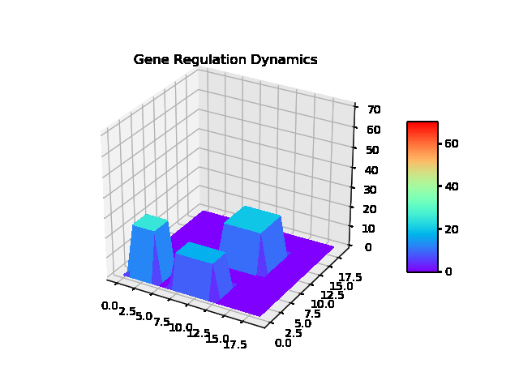
Why Is It Hard?
Complex nonlinear dynamics on graphs
+
→
Linear Dynamics
+
→
Linear Dynamics
$$f(X\left(t\right), G, θ,t)$$
?
+
→
Non-Linear Dynamics

Slide 29
This Tutorial
Molecular Graph Generation: to generate novel molecules with optimized properties
Graph generation
Graph property prediction
Graph optimization
Learning Dynamics on Graphs: to predict temporal change or final states of complex systems
Continuous-time network dynamics prediction
Structured sequence prediction
Node classification/regression
Mechanism discovery: to find dynamical laws of complex systems
Density Estimation vs. Mechanism Discovery
Data-driven discovery of differential equations

Slide 30
This Tutorial
www.calvinzang.com/DDLG_AAAI_2020.html
AAAI-2020
Friday, February 7, 2020, 2:00 PM -6:00 PM
Sutton North, Hilton New York Midtown, NYC

Slide 31
Thank You!
Differential Deep Learning on Graphs and its Applications
Chengxi Zang and Fei Wang
Weill Cornell Medicine
www.calvinzang.com

